Slide 1
Support Services Annual FY24 Insights

Slide 2
Web Analytics Summary
Program Roll-up

Slide 3
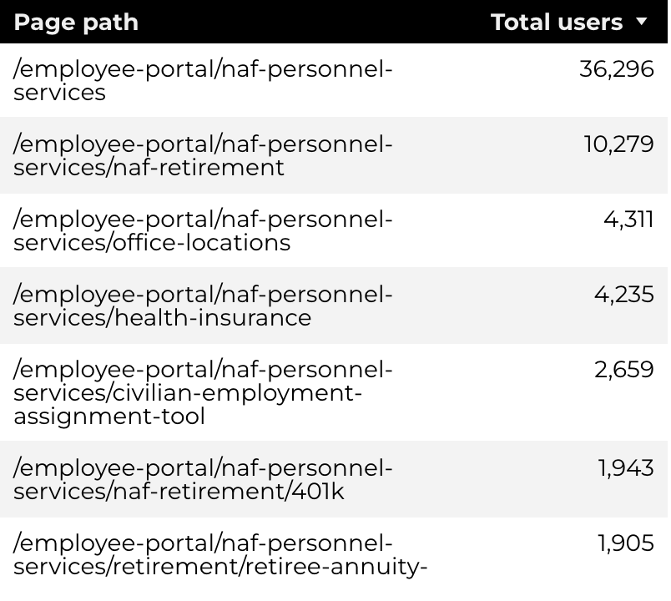
Traffic Highlights
Top Pages NAF Personnel Services
The program received 102,838 views and 65,266 sessions.
The engagement rate was at 66%.
There were a total of 54,374 users. Of those users, 40,527 were new.
NAF Personnel Services

Slide 4
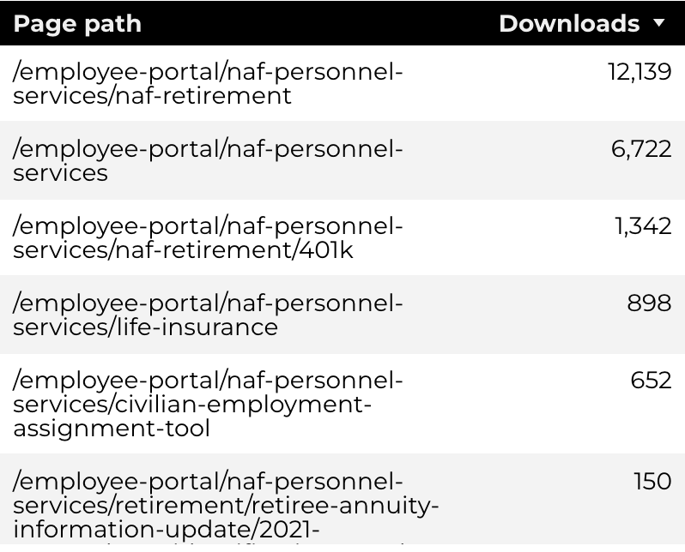
Engagement Insights & Highlights
22,033 people downloaded a PDF or a form.
Top pages for downloads, click-throughs on email addresses, phone numbers, and outbound links
.
NAF Personnel Services

Slide 5
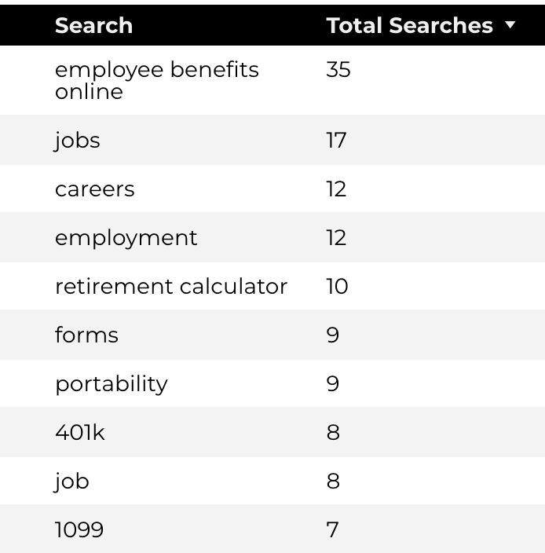
Search Insights & Highlights
Top Searches
There were 646 total on-site searches on NAF Personnel Services pages to find more information.
0.72% of users left the site after performing a search.
NAF Personnel Services

Slide 6
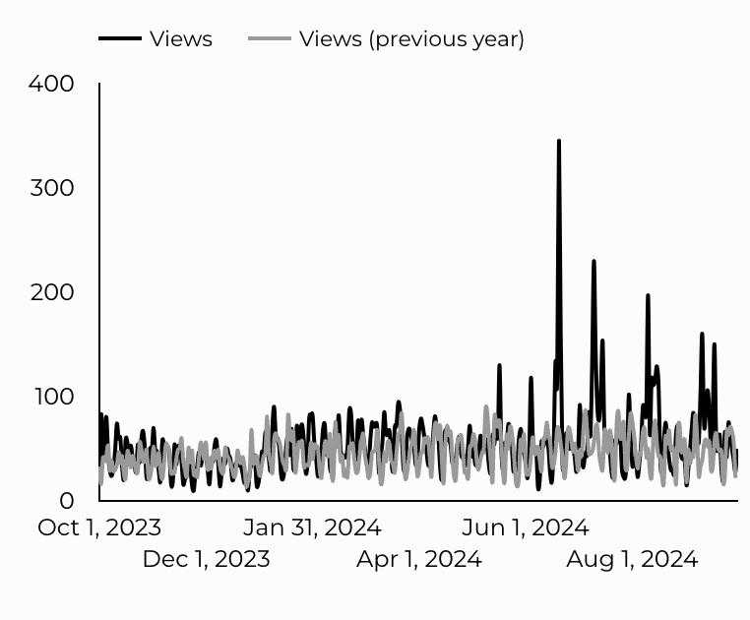
Traffic Highlights
The website received 19,994 views and 16,615 sessions.
The engagement rate was at 82%.
CEAT

Slide 7
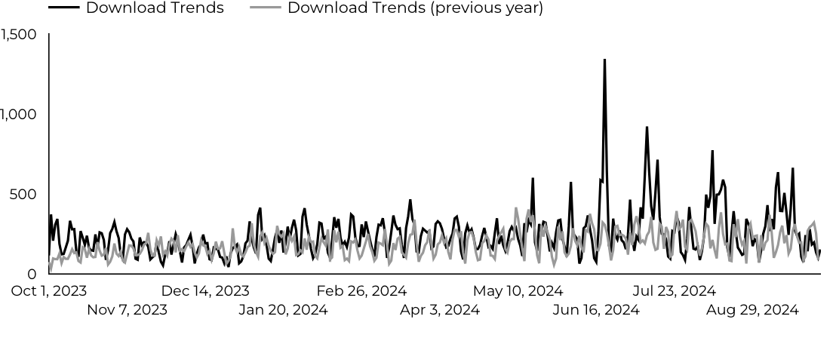
Engagement Insights & Highlights
CEAT Transfer Guide Achieved 2,465 Downloads.
CEAT Transfer Guide Download Trends
CEAT

Slide 8
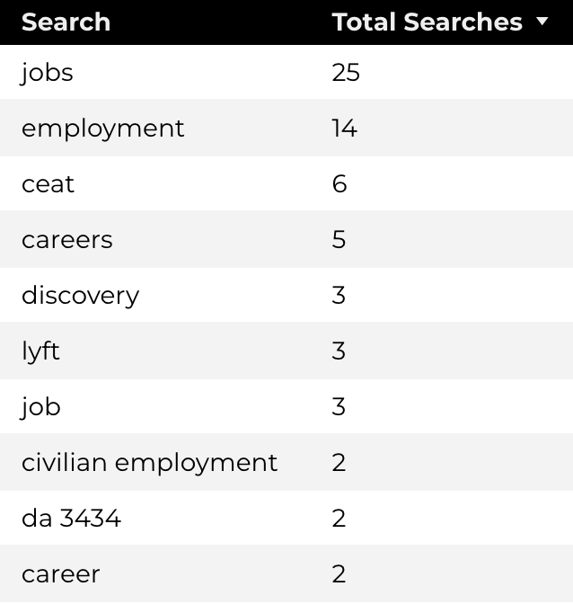
Search Insights & Highlights
178 total on-site searches on CEAT pages to find more information.
Top Searches
CEAT

Slide 9
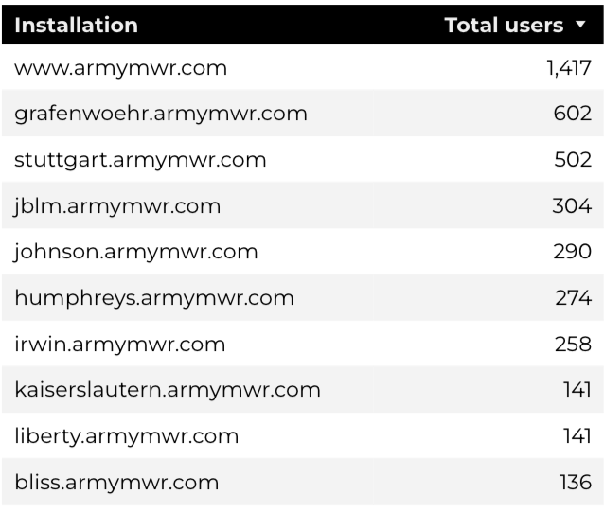
Traffic Highlights
HBB pages received 33,930 views and 29,909 sessions.
The engagement rate was at 66%.
The total number of users was 24,069, and there were 11,997 new users.
Top Installations
Home Based Business (HBB)

Slide 10
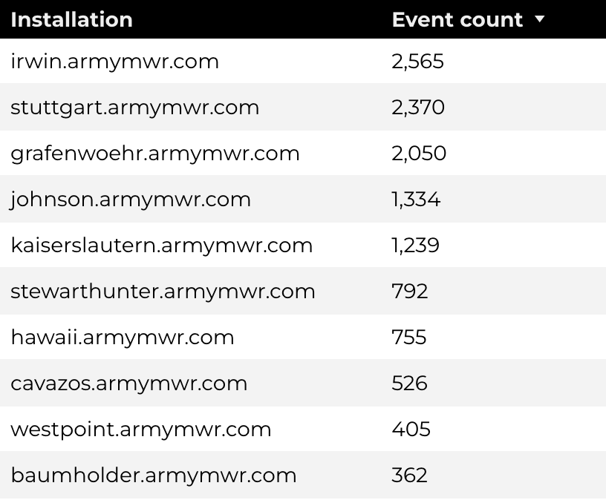
Engagement Insights & Highlights
There were 1,192 clicks to other websites to find more information.
13,067 people downloaded a PDF or a form.
761 people needed to talk to a real person.
Top Installations
(Downloads, Email, Phone Numbers, Outbound Links)
Home Based Business (HBB)

Slide 11
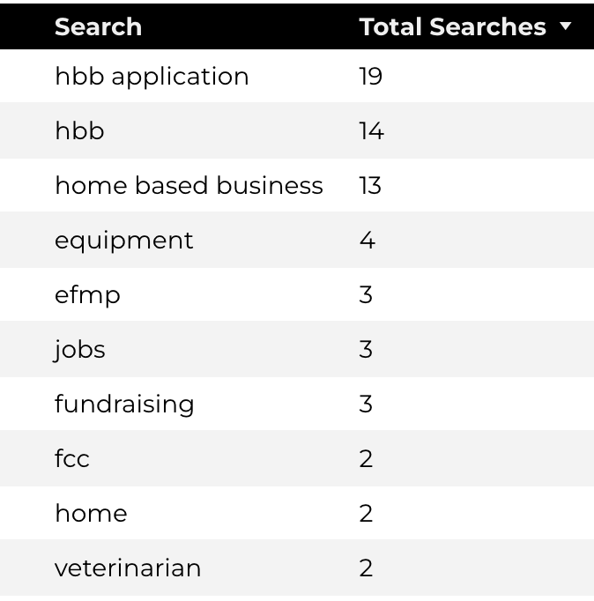
Search Insights & Highlights
235 total on-site searches on HBB pages to find more information.
4.25% of users left the site after performing a search.
Top Searches
Home Based Business (HBB)

