Slide 1
Support Services First Quarter FY25 Insights

Slide 2
Web Analytics Summary
Program Roll-up

Slide 3
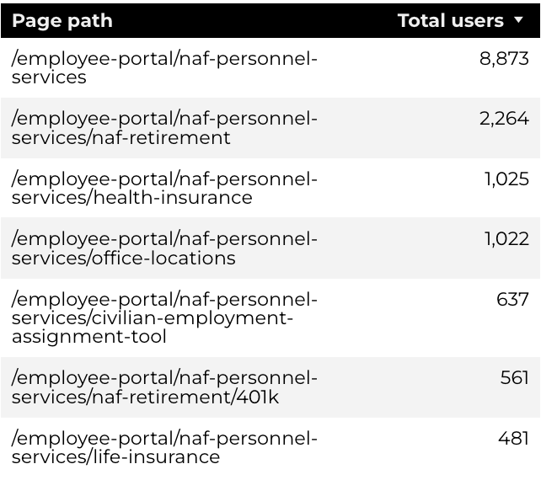
Traffic Highlights
Top Pages NAF Personnel Services
The program received 22,750 views and 14,953 sessions.
The engagement rate was at 65%.
There were a total of 13,081 users.
NAF Personnel Services

Slide 4
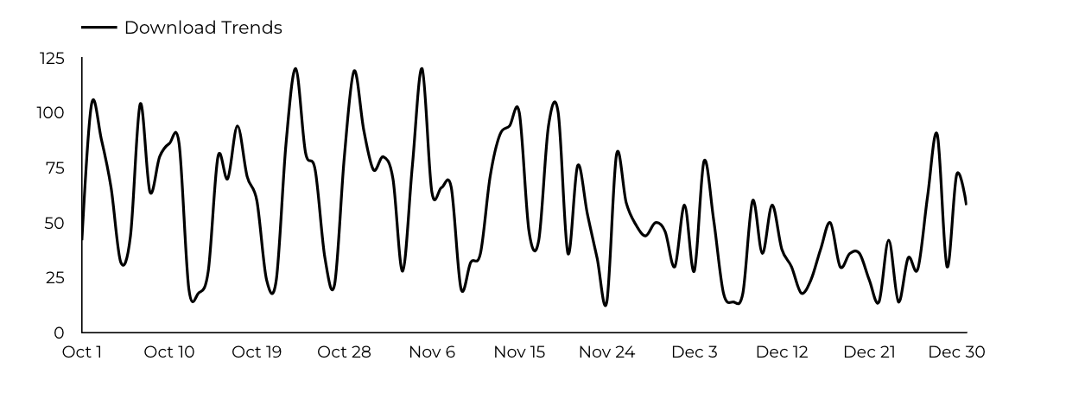
Engagement Insights & Highlights
5,313 people downloaded a PDF or a form.
187 people clicked on a link to another website to get more information.
NAF Personnel Services

Slide 5
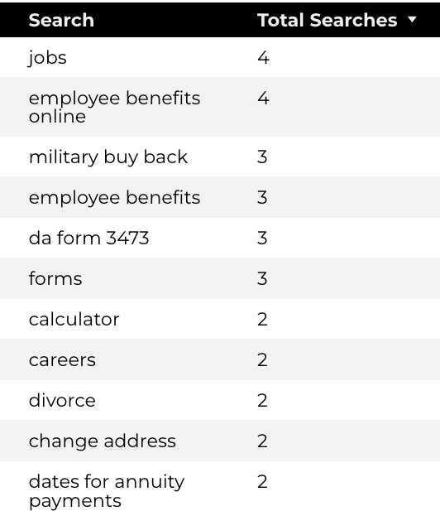
Search Insights & Highlights
Top Searches
There were 105 total on-site searches on NAF Personnel Services pages to find more information.
NAF Personnel Services

Slide 6
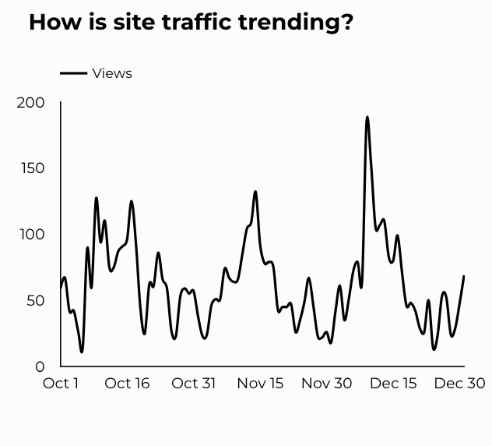
Traffic Highlights
The website received 5,752 views and 4,100 sessions.
The engagement rate was at 82%.
CEAT

Slide 7
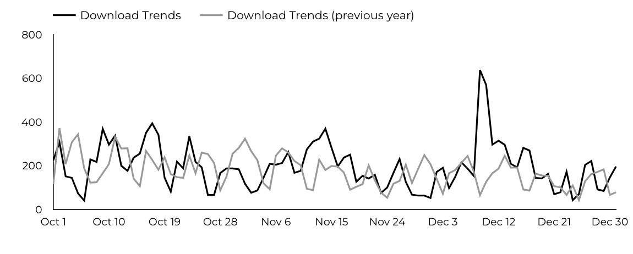
Engagement Insights & Highlights
CEAT Transfer Guide: Achieved 626 Downloads.
CEAT Transfer Guide Download Trends
CEAT

Slide 8
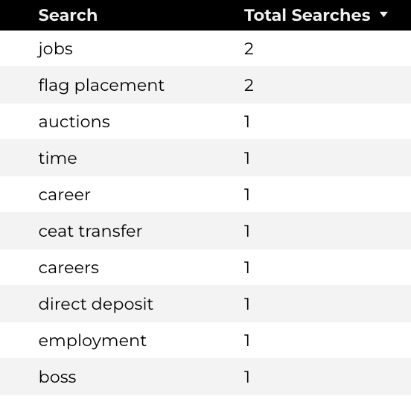
Search Insights & Highlights
Top Searches
30 total on-site searches on CEAT pages to find more information.
CEAT

Slide 9
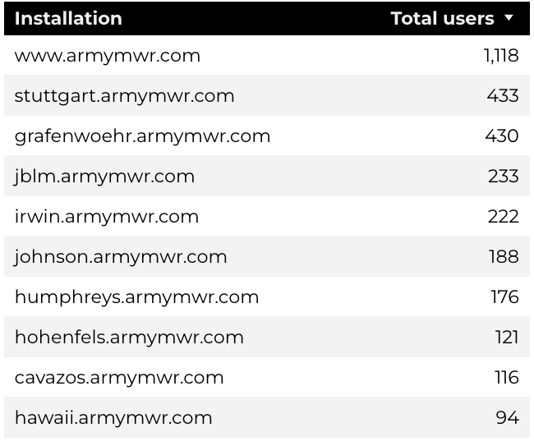
Traffic Highlights
Top Installations
HBB pages received 7,204 views and 5,648 sessions.
The engagement rate was at 71%.
The total number of users was 4,739, and there were 2,221 new users.
Home Based Business (HBB)

Slide 10
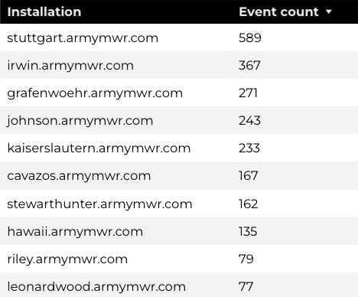
Engagement Insights & Highlights
There were 204 clicks to other websites to find more information.
2,444 people downloaded a PDF or a form.
129 people needed to talk to a real person.
Top Installations
(Downloads, Email, Phone Numbers, Outbound Links)
Home Based Business (HBB)

Slide 11
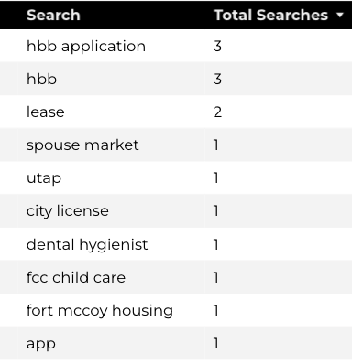
Search Insights & Highlights
43 total on-site searches on HBB pages to find more information.
8.85% of users left the site after performing a search.
Top Searches
Home Based Business (HBB)

