Slide 1
Support Services First Quarter FY24 Insights
01 OCT – 31 DEC
​

Slide 2
EPW Search Engagement Improvement

Slide 3
Web Analytics Summary
Program Roll-up

Slide 4
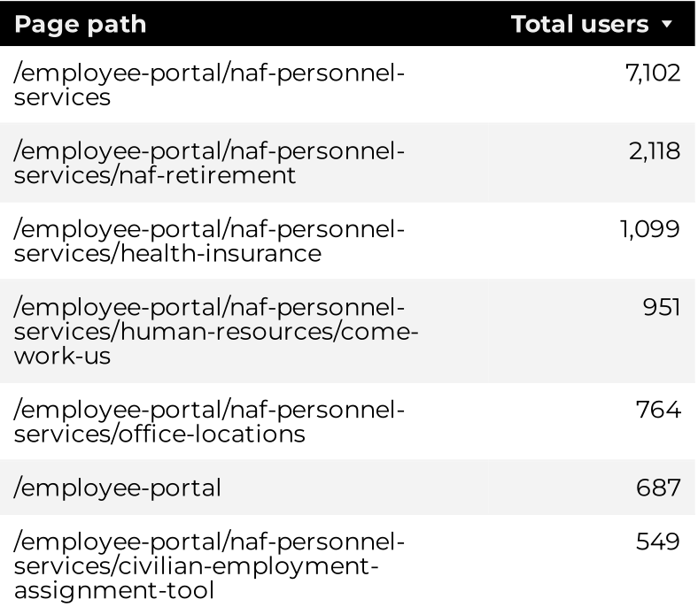
Traffic Highlights
NAF Personnel Services
Top Pages
The program received 23,406 views and 14,172 sessions.
The engagement rate was at 66%.
There were a total of 11,901 users. Of those users, 8,100 were new.

Slide 5
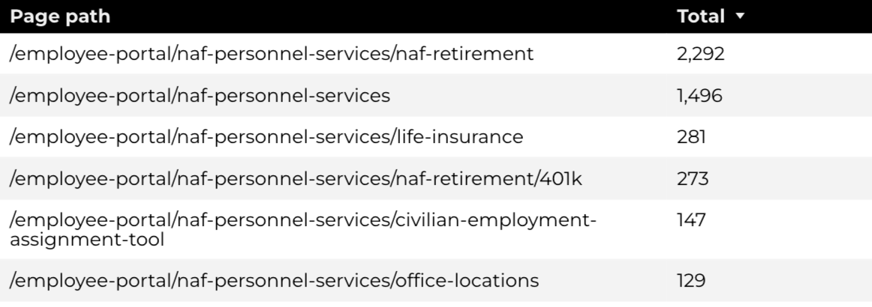
Engagement Insights & Highlights
NAF Personnel Services
There were 4,912 clicks to find more information.
4,520 people downloaded a PDF or a form.
392 people clicked on a link to another website to get more information.
Top pages for downloads, click-throughs on email addresses, phone numbers, and outbound links.

Slide 6
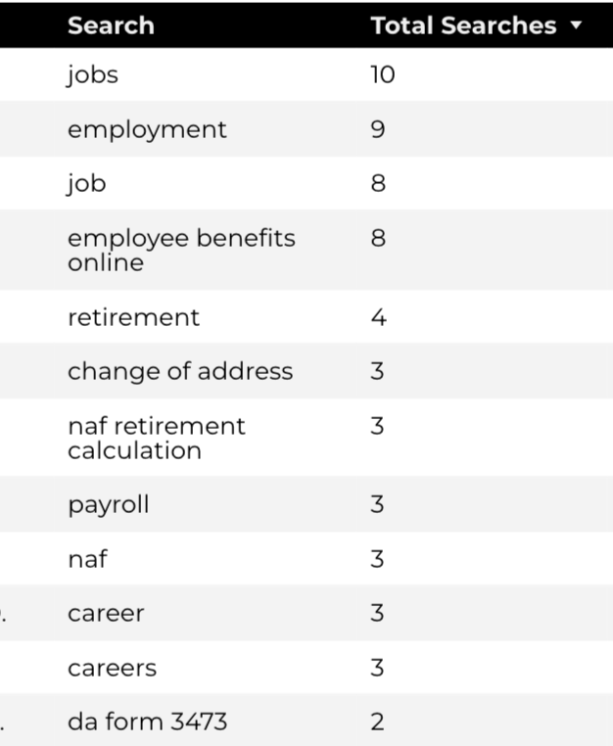
Search Insights & Highlights
NAF Personnel Services
Top Searches
There were 176 total on-site searches on NAF Personnel Services pages to find more information.
0.65% of users left the site after performing a search.

Slide 7
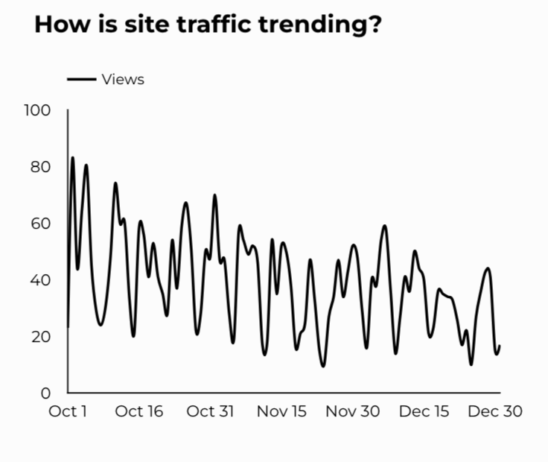
Traffic Highlights
CEAT
CEAT Traffic Trends
The website received 3,592 views and 3,316 sessions.
The engagement rate was at 83%.
There are a total of 2,867 users. Of those users 467 were new.

Slide 8
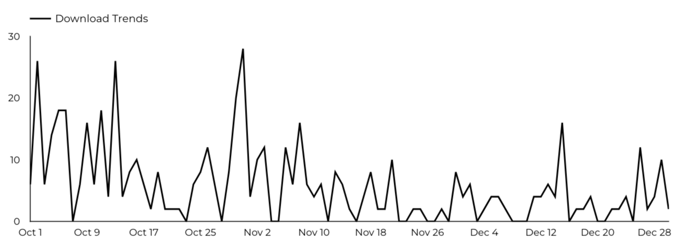
Engagement Insights & Highlights
CEAT
CEAT Transfer Guide: Achieved 452 Downloads
CEAT Transfer Guide Download Trends

Slide 9
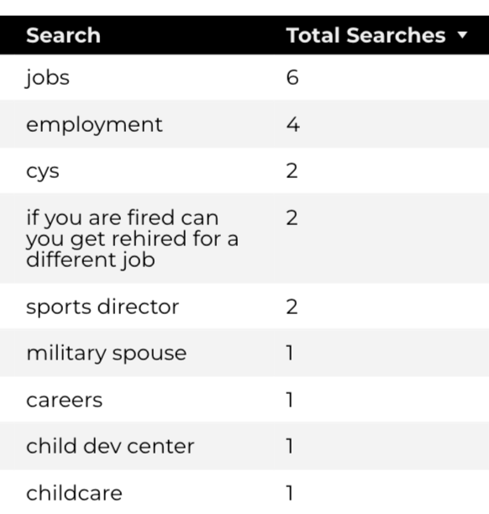
Search Insights & Highlights
CEAT
Top Searches
40 total on-site searches on CEAT pages to find more information.
2.86% of users left the site after performing a search.

Slide 10
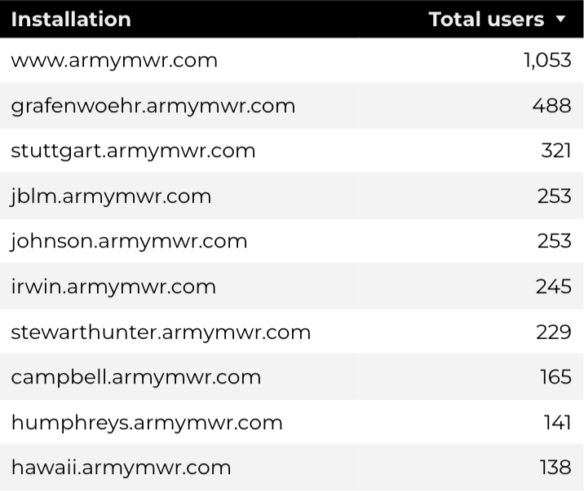
Traffic Highlights
Home Based Business (HBB)
Top Installations
HBB pages received 6,320 views and 5,669 sessions.
The engagement rate was at 70%.
The total number of users was 4,604, and there were 2,118 new users.

Slide 11
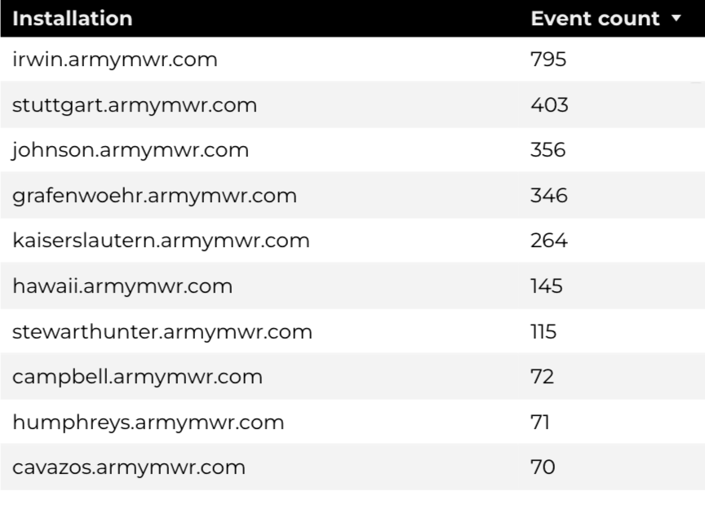
Engagement Insights & Highlights
Home Based Business (HBB)
Top Installations
(Downloads, Email, Phone Numbers, Outbound Links)
There were 267 clicks to other websites to find more information.
2,668 people downloaded a PDF or a form.
196 people needed to talk to a real person.

Slide 12
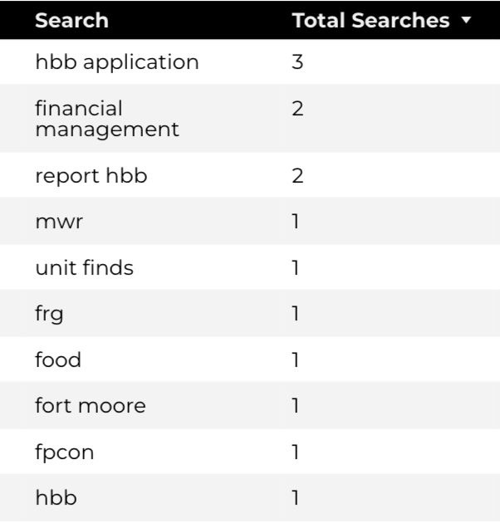
Search Insights & Highlights
Home Based Business (HBB)
Top Searches
34 total on-site searches on HBB pages to find more information.
0% of users left the site after performing a search.

