Slide 1
BRD Fourth Quarter FY24 Insights

Slide 2
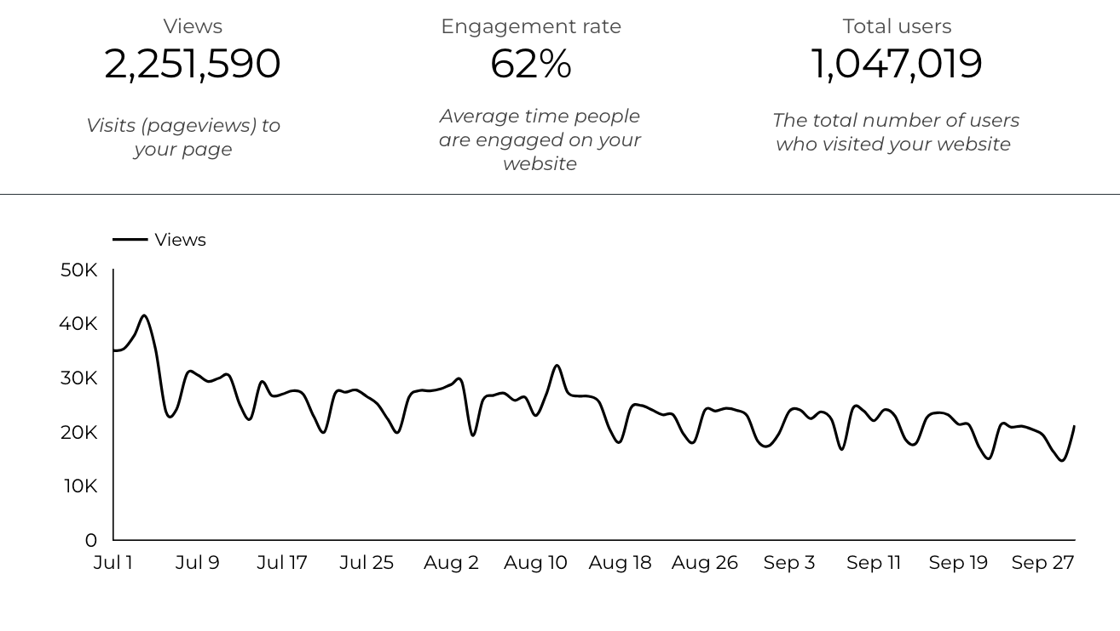
Web Analytics Summary

Slide 3
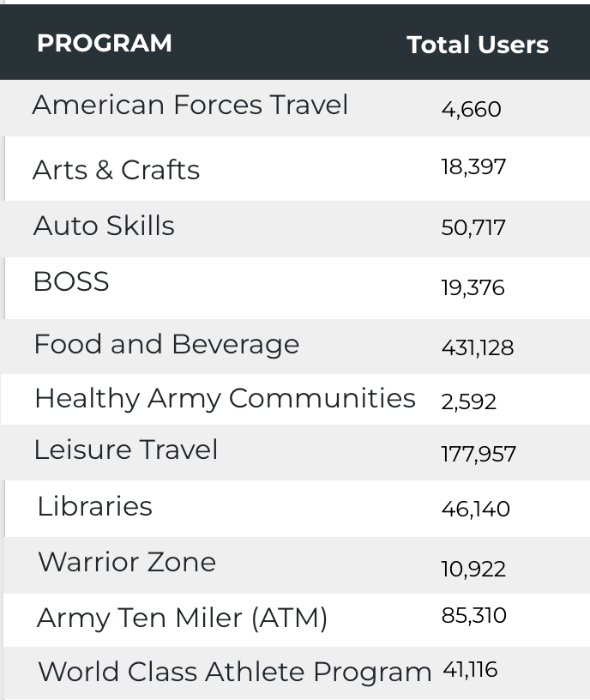
Visitor Highlights
12,249 People clicked on the Chow Now button to start an order.

Slide 4
Sports and Fitness
28,988 People clicked to schedule a tee time or register for a golf clinic.

Slide 5
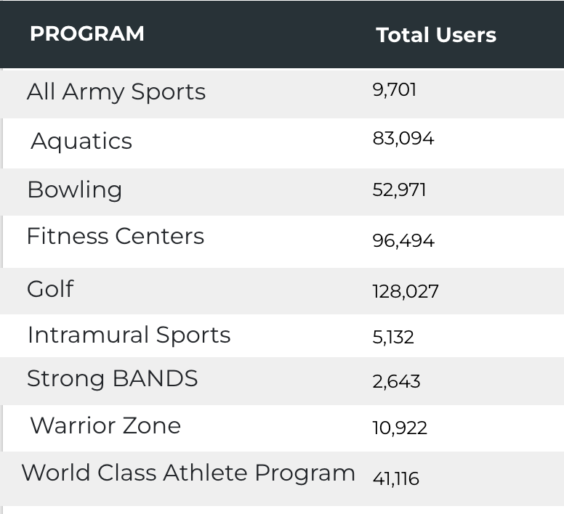
Visitor Highlights
Sports and Fitness

Slide 6
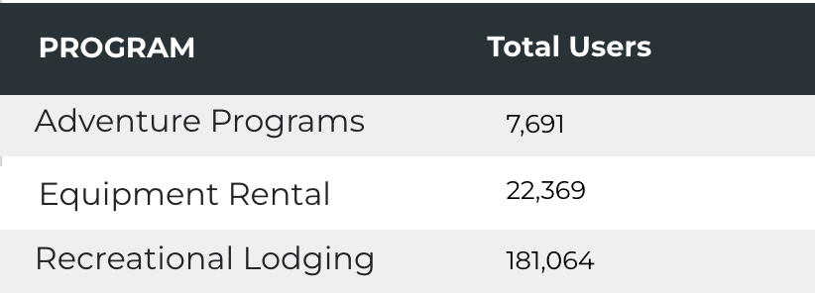
Visitor Highlights
Outdoor Rec

Slide 7
Visitor Highlights
How engaged were these visitors within the website?
On average, users visited 2.16 pages per visit.
On average, users stayed on the site for 2 minutes and 38 seconds per visit.
802,209 visitors were new to the website.
62% of visitors took action on a page!

Slide 8
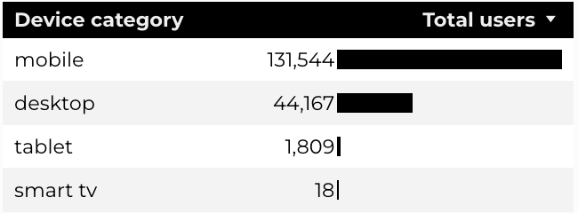
Traffic Highlights
BRD pages received 2,251,591 visits last quarter.
The majority of social traffic came from Facebook.
Users by Device Category

Slide 9
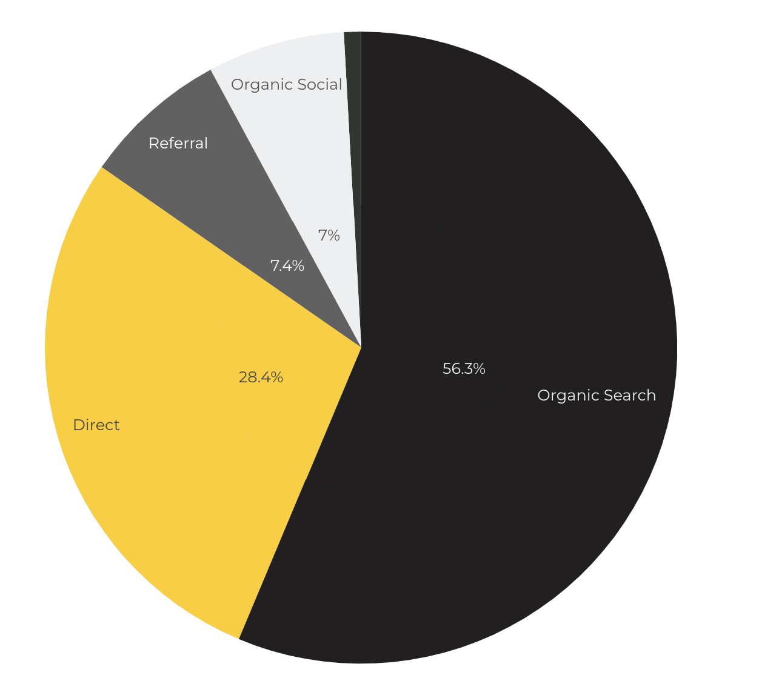
Marketing Reach
Other
|
56.3% of visitors came from online search engines.
28.4% came directly to the site (by typing in the address, using bookmarks, or email links).
7% of visitors came from social media.
7.4% of visitors came from referrals.
0.9% Other (traffic that has an acquisition source Google doesn't know how to classify).

Slide 10
Engagement Insights & Highlights
Last quarter had a total of 780,278 interactions on the pages (including downloads, email clicks, phone number clicks, outbound links, and videos).

Slide 11
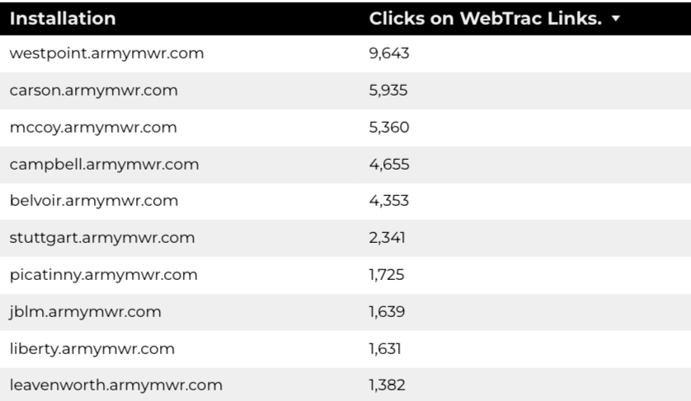
WebTrac Insights & Highlights
A total of 50,648 individuals clicked on a WebTrac link from a program page.
Top installations with the highest number of WebTrac link clicks on pages.

Slide 12
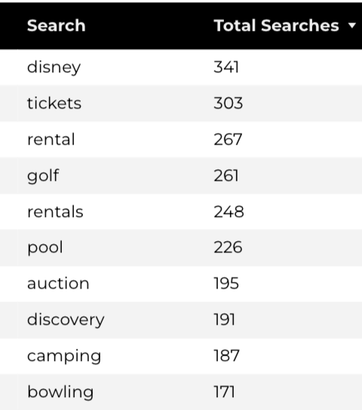
Search Insights
30,240 Total on-site searches on BRD pages to find more information.

Slide 13
Search Intent
Search intent is defined as being the underlying purpose behind an online query.
44% of searches were looking for an answer to a specific question or general information.
42% of searches were looking to investigate brands or services and intending to complete an action or purchase.
14% of searches were intending to find a specific program page using the on-site search.

Slide 14
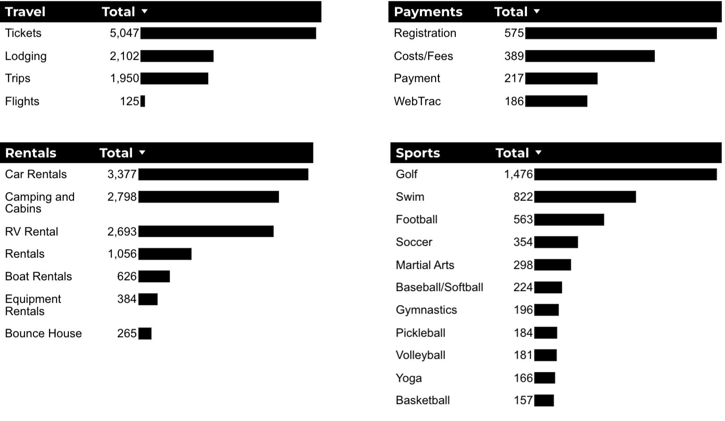
What Are The Top Search Sub-Topics?
The most popular search categories and terms within BRD

