Slide 1
BRD First Quarter FY23 Insights
01 Oct – 31 Dec
​

Slide 2
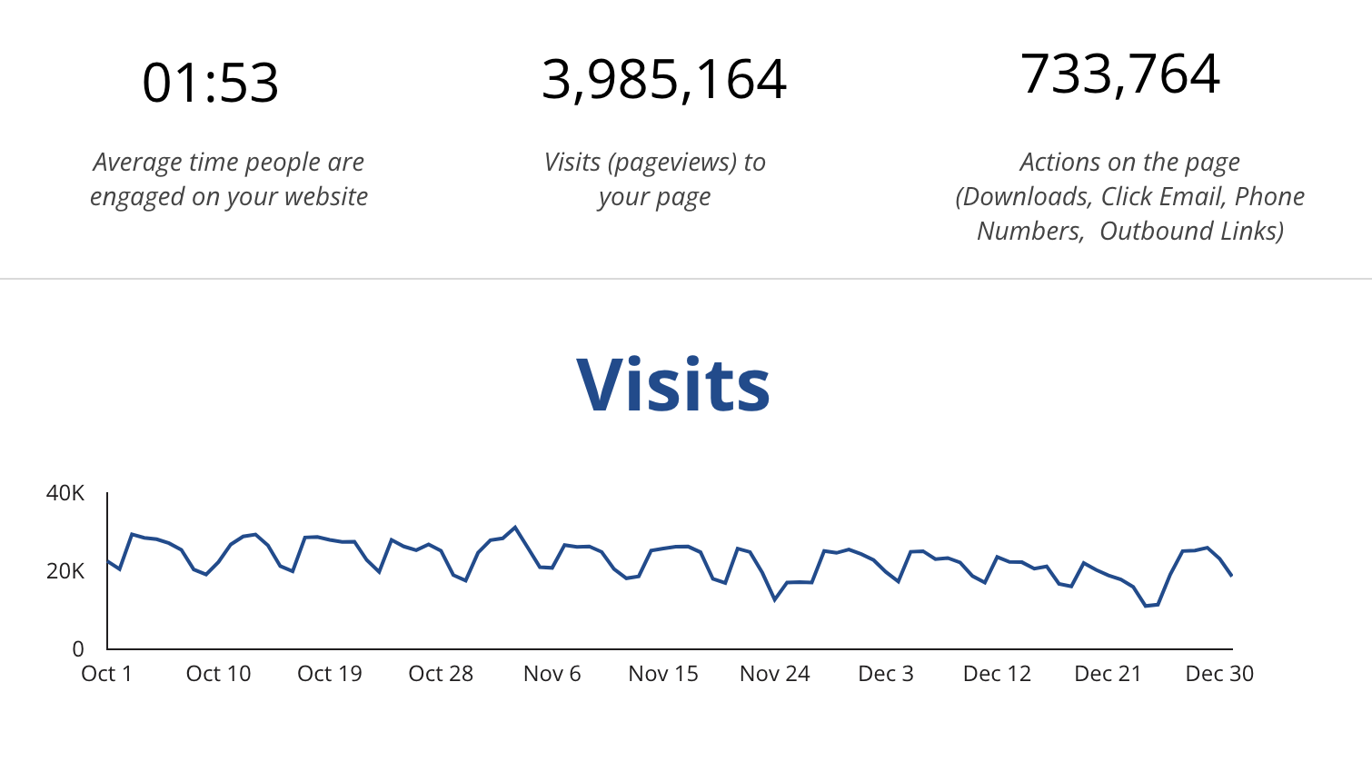
Web Analytics Summary

Slide 3
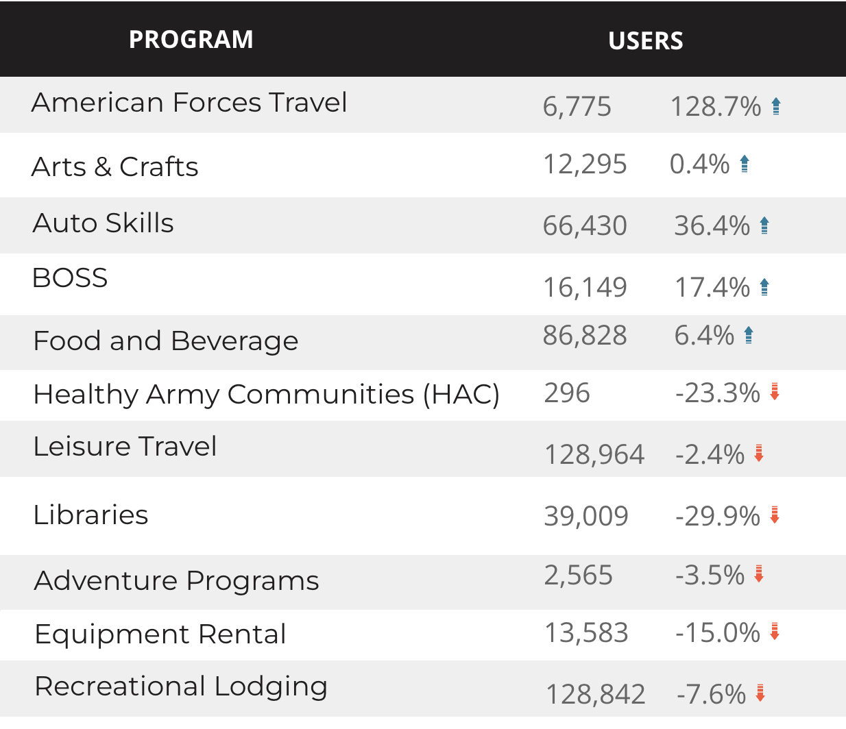
Visitor Highlights
3,513 People clicked on the Chow Now button to start and order.
+43.8% increase compared to previous year

Slide 4
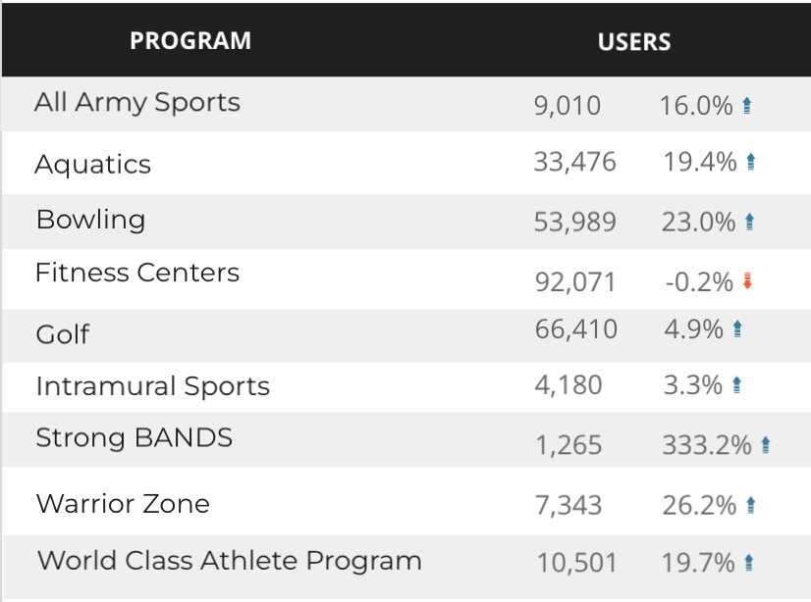
Sport and Fitness
7,779 People clicked to schedule a tee time or register for a golf clinic.
+19.8% from the previous year

Slide 5
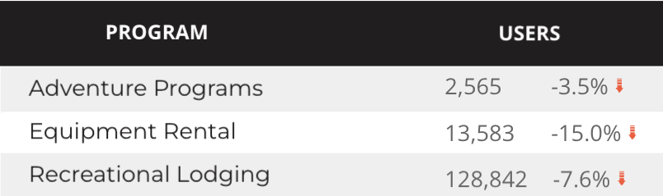
Visitor Highlights
Outdoor Rec

Slide 6
Traffic Highlights
3,985,164 Visits (pageviews to BRD pages).
Traffic to BRD increased by +4.1% from the previous year. This increase is primarily due to direct and organic traffic.
Social traffic is +8.9% higher than the previous year.

Slide 7
Visitor Highlights
How engaged were these visitors within the website?
On average, users visited 2.04 pages per visit.
On average, users stayed on the site for 1:51 minutes per visit.
1,179,744 visitors were new to the website.
New visitors increased 6.5% compared to last year!

Slide 8
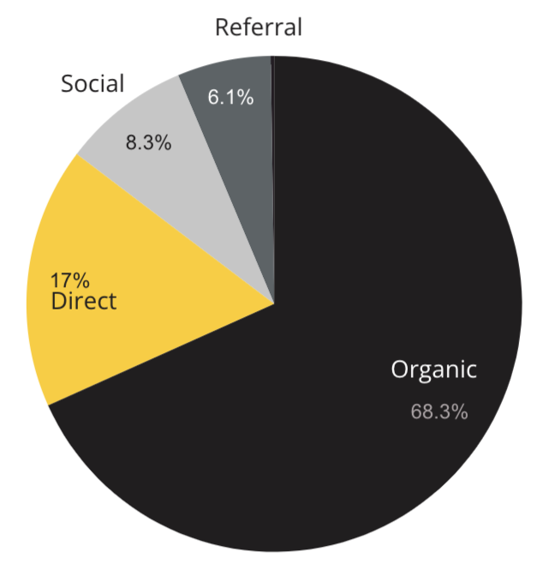
Marketing Reach
68.3% of visitors came from online search engines.
17% came directly to the site (by typing in the address, using bookmarks, or email links).
8.3% of visitors came from social media.
6.1% of visitors came from referrals.
.03% Other (traffic that has an acquisition source Google doesn’t know how to classify).

Slide 9
Engagement Insights & Highlights
Last quarter had a total of 739,732 interactions on the pages (interactions are downloads, email clicks, phone number clicks, and outbound links).
+8.3% from the previous year.

Slide 10
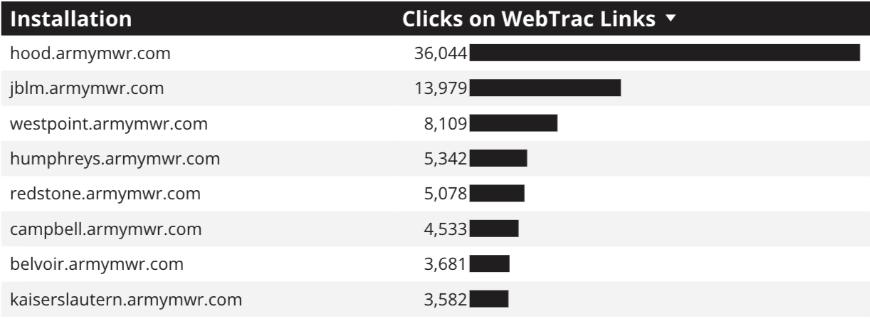
WebTrac Insights & Highlights
104,984 People clicked on a WebTrac link from a program page to register or pay for a program.
+43% from the previous year!

Slide 11
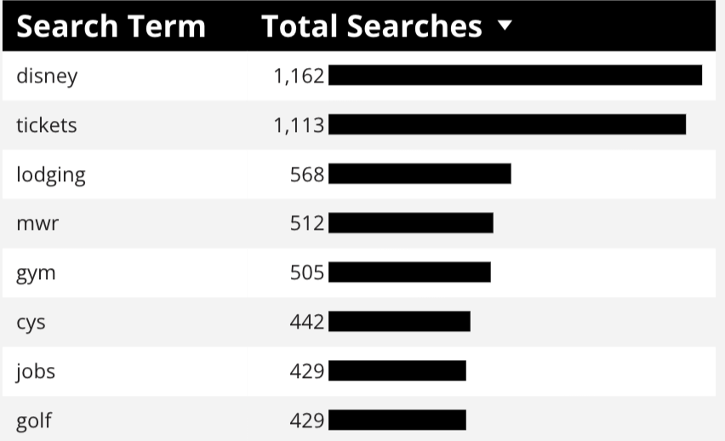
Search Insights
64,794 Total on-site searches on BRD pages to find more information.
19.62% of users searched again immediately after performing a search.

Slide 12
Search Intent
Search intent is defined as being the underlying purpose behind an online query.
42% Searches looking to investigate brands or services and intending to complete an action or purchase.
45% Searches looking for an answer to a specific question or general information.
13% Searches intending to find a specific program, page using the onsite search.

Slide 13
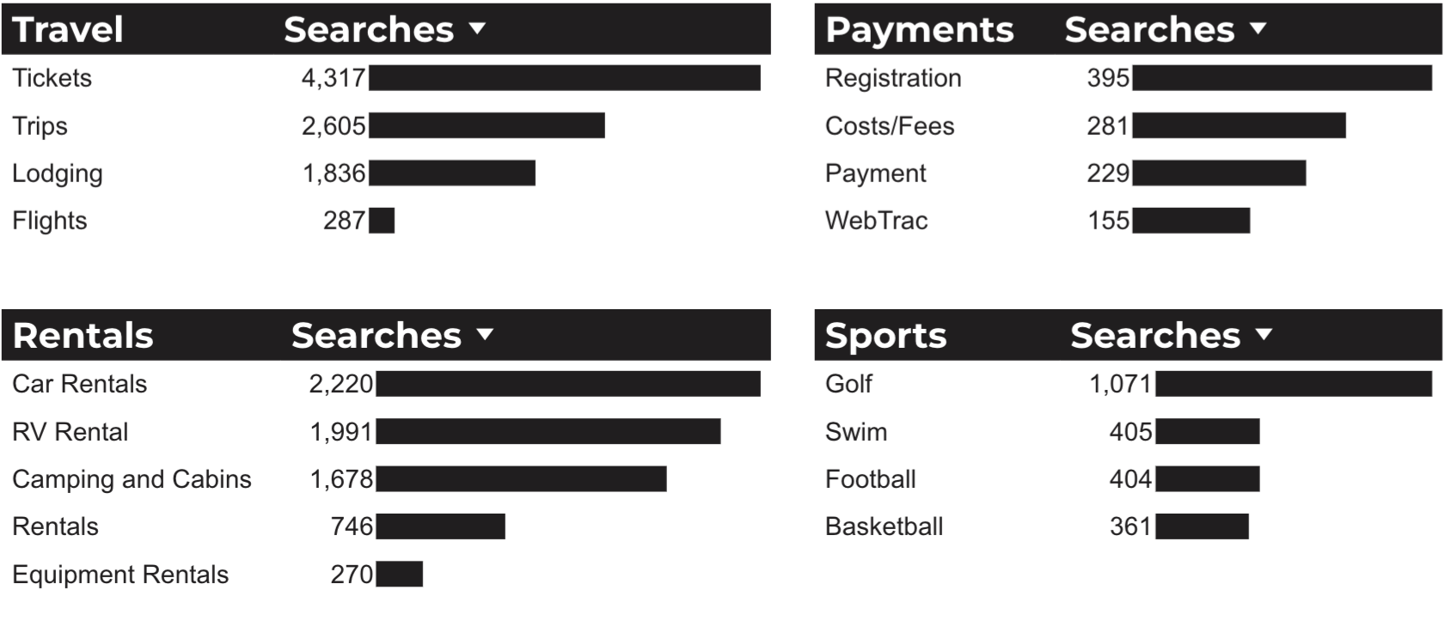
What Are The Top Search Sub-Topics?
The most popular search categories > terms within BRD

