Slide 1
BRD Annual FY23 Insights
01 Oct – 30 Sept
​

Slide 2
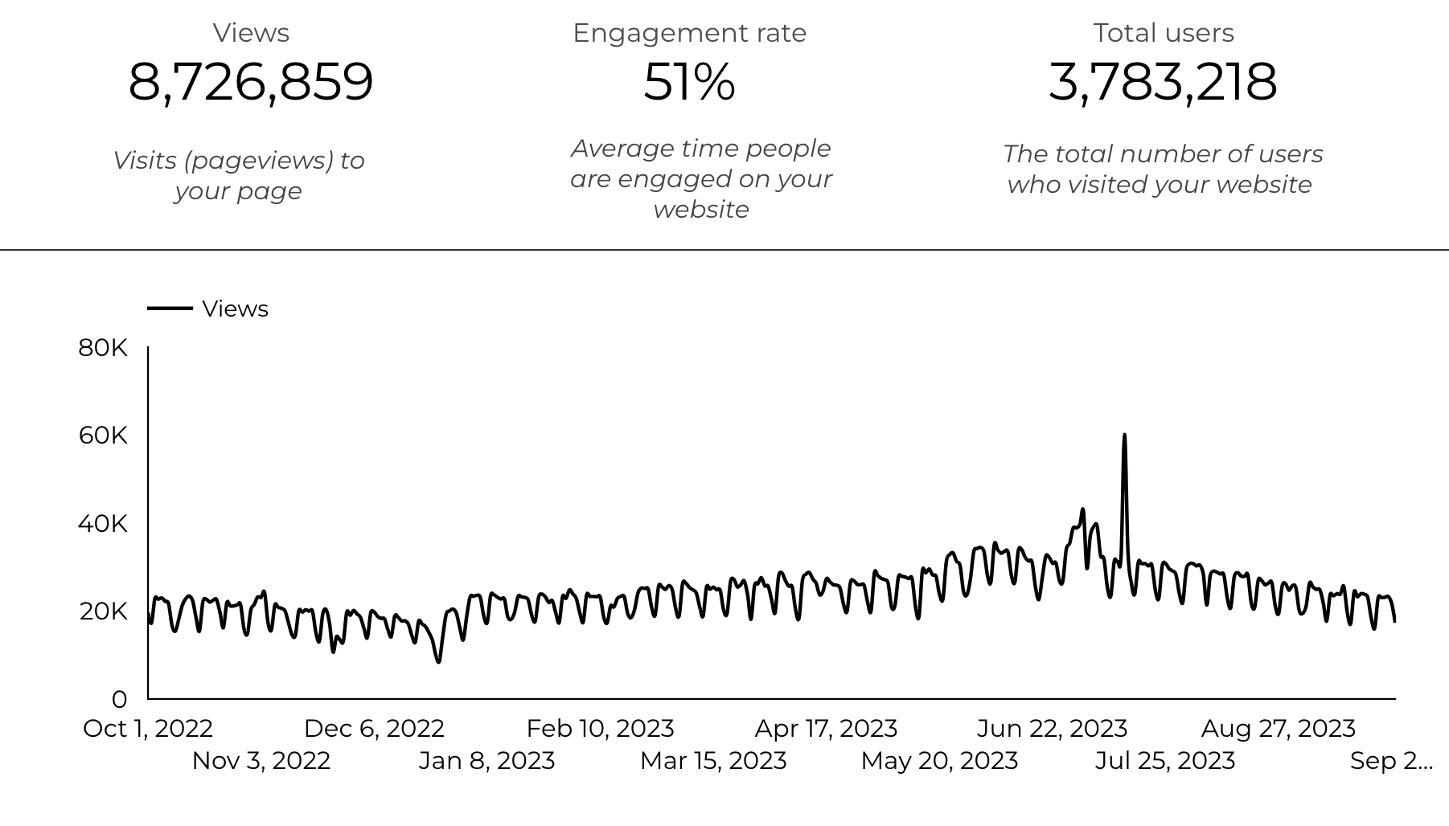
Web Analytics Summary

Slide 3
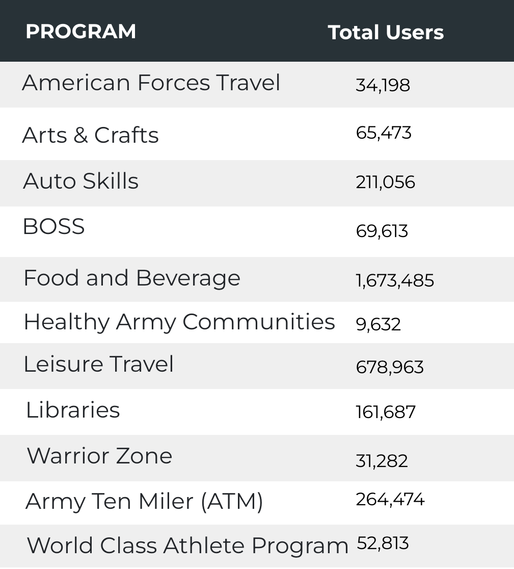
Visitor Highlights
28,156 People clicked on the Chow Now button to start and order.

Slide 4
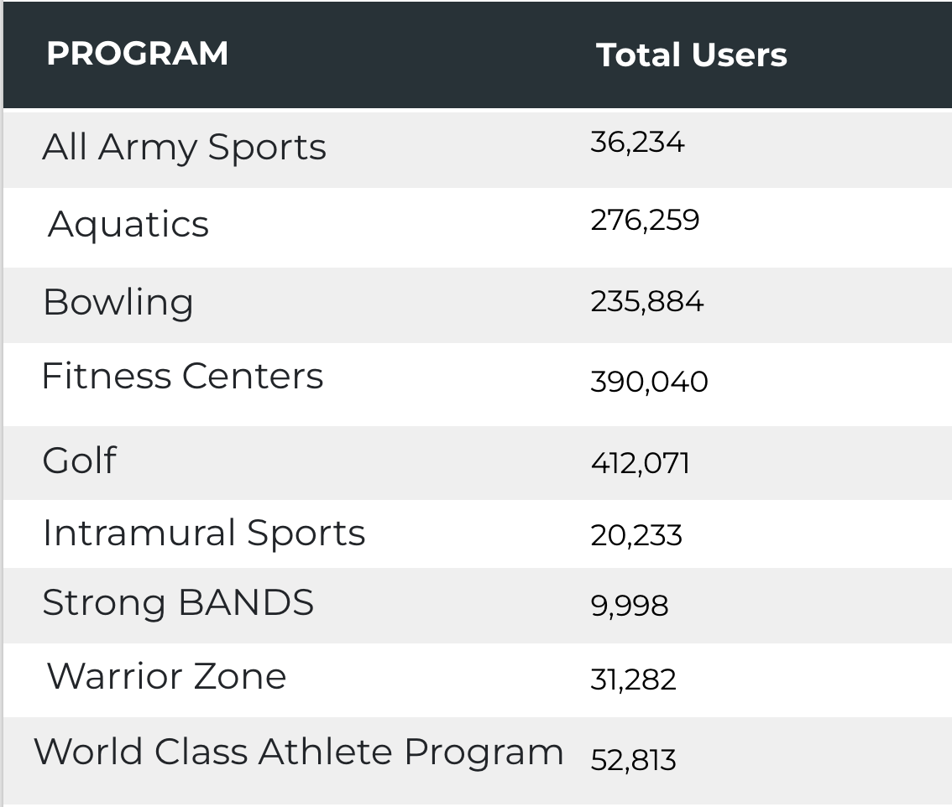
Visitor Highlights
Sports and Fitness
62,216 People clicked to schedule a tee time or register for a golf clinic.

Slide 5
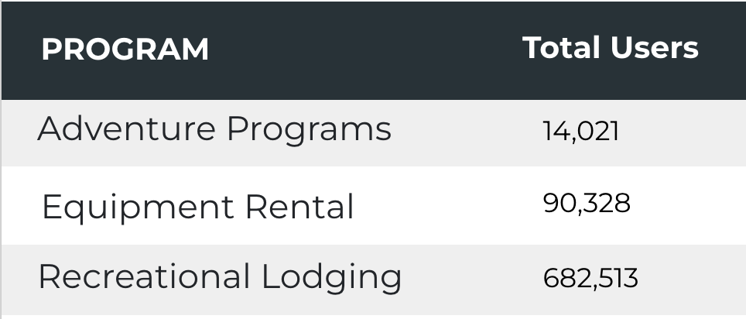
Visitor Highlights
Outdoor Rec

Slide 6
Visitor Highlights
How engaged were these visitors within the website?
On average, users visited 2.31 pages per visit.
On average, users stayed on the site for 2 minutes and 51 seconds per session.
3,083,104 visitors were new to the website.
51% of visitors take action on a page!

Slide 7
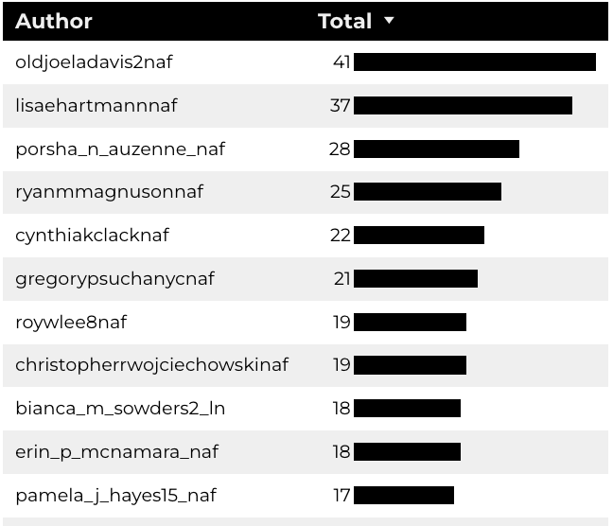
Top 10 Content Creators

Slide 8
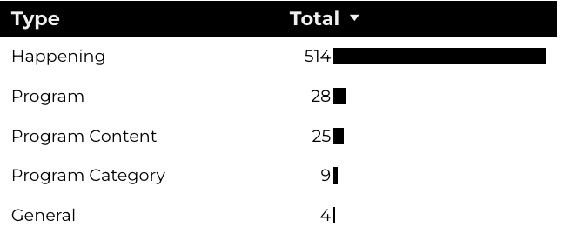
New Pages
Web managers created 580 new BRD pages, program pages, and happenings on EPW last year. (Data from EPW Page Report)

Slide 9
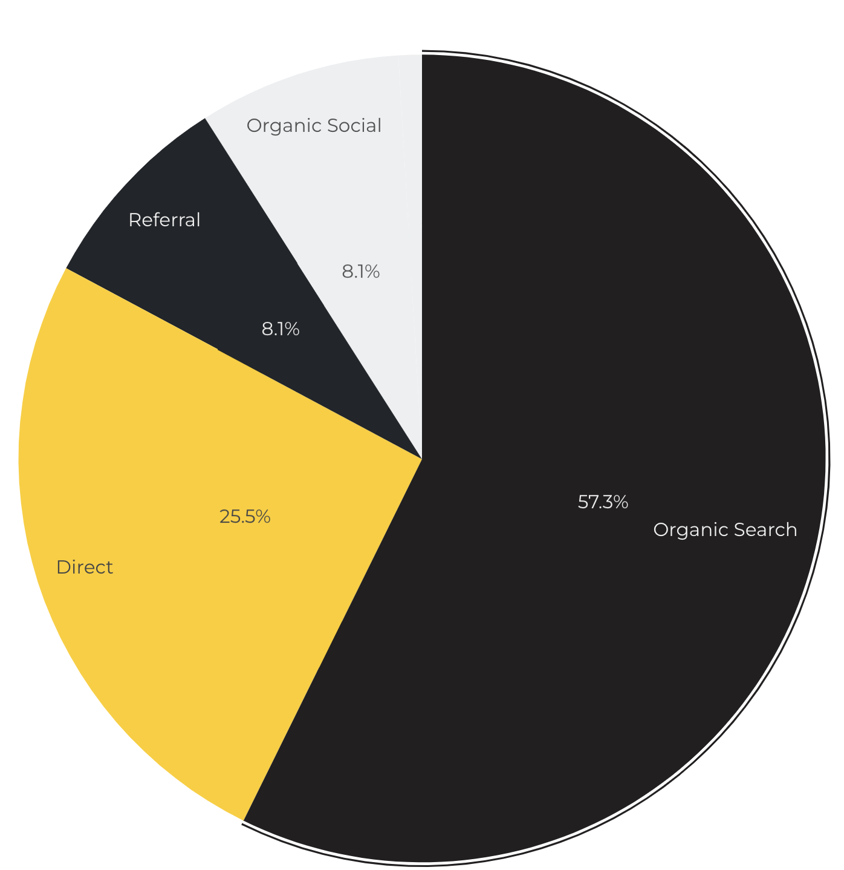
Marketing Reach
57.3% of visitors came from online search engines.
25.5% came directly to the site (by typing in the address, using bookmarks, or email links).
8.1% of visitors came from social media.
8.1% of visitors came from referrals.

Slide 10
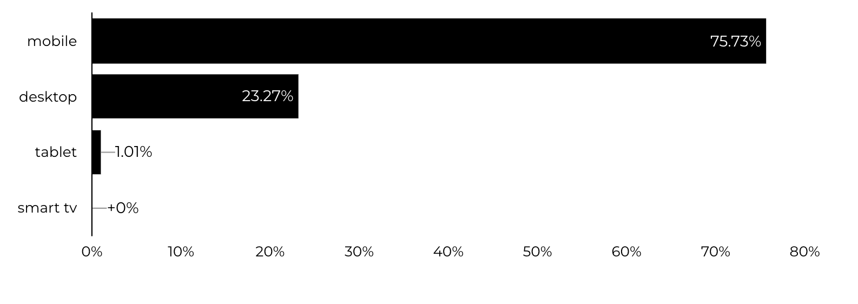
Engagement Insights & Highlights
Last year had a total of 3,418,969 interactions on the pages (including downloads, email clicks, phone number clicks, outbound links, and videos).
Devices Driving Engagement

Slide 11
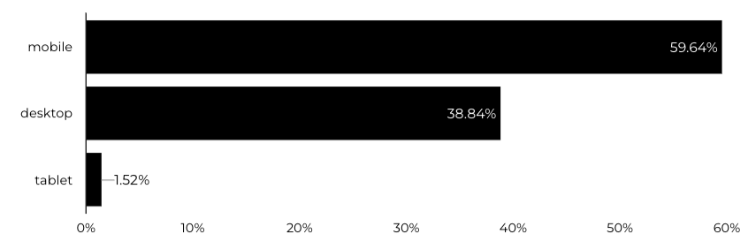
WebTrac Insights & Highlights
385,390 People clicked on a WebTrac link from a program page to register or pay for a program.
Devices Driving Engagement

Slide 12
Summer Reading Program
1 May – 30 Sept
13,560 Users made a visit.
Of those users, 4,954 are new.
26% of Visitors Take Action on a Page.
653,032 Stripe Impressions.
391 People Clicked a UnitedThroughReading.org Link.
3,503 People Clicked a Beanstack.com Link.
78 People Click the sweepstakes link.

Slide 13
Search Intent
Search intent is defined as being the underlying purpose behind an online query.
44% of searches were looking for an answer to a specific question or general information.
43% of searches were looking to investigate brands or services and intending to complete an action or purchase.
13% of searches were intending to find a specific program page using the on-site search.

Slide 14
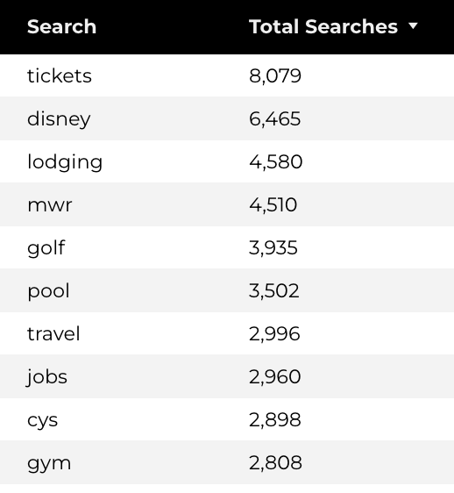
Search Insights
512,818 Total on-site searches on BRD pages to find more information.

Slide 15
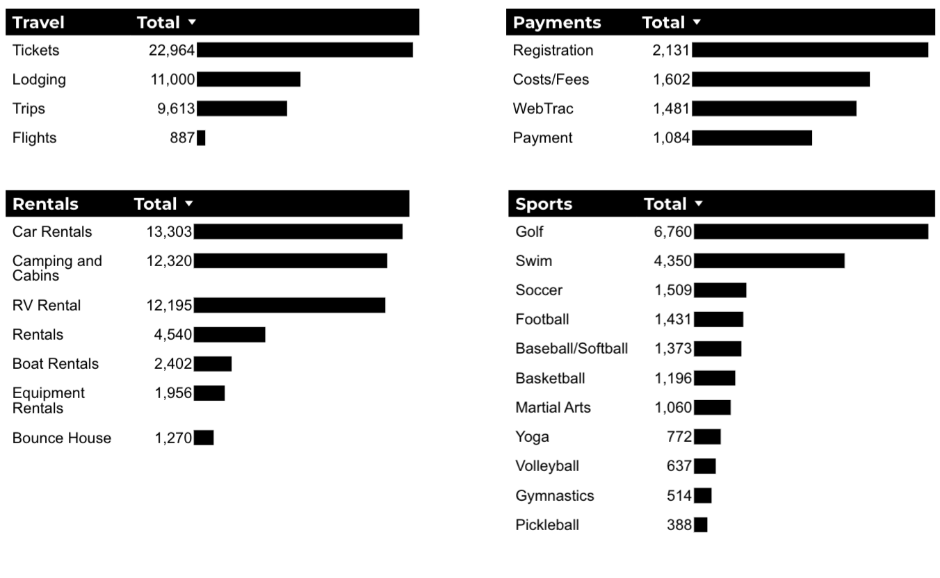
What Are The Top Search Sub-Topics?
The most popular search categories > terms within BRD

