Slide 1
Support Services FY24 Insights

Slide 2
Web Analytics Summary
Program Roll-up

Slide 3
Traffic Highlights
Top Pages NAF Personnel Services
The program received 26,077 views and 16,901 sessions.
The engagement rate was at 67%.
There were a total of 14,619 users. Of those users, 10,971 were new.
NAF Personnel Services

Slide 4
Engagement Insights & Highlights
5,631 people downloaded a PDF or a form.
644 people clicked on a link to another website to get more information.
Top pages for downloads, click-throughs on email addresses, phone numbers, and outbound links.
NAF Personnel Services

Slide 5
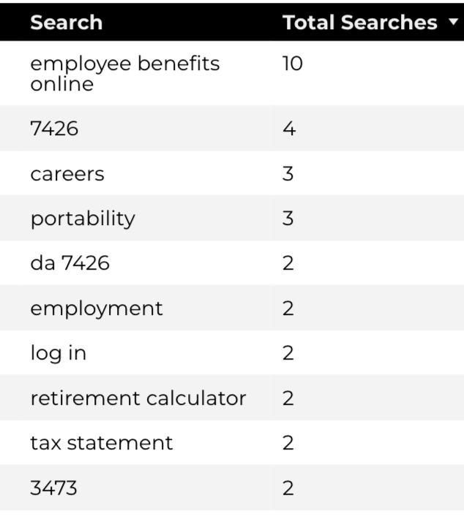
Search Insights & Highlights
Top Searches
There were 145 total on-site searches on NAF Personnel Services pages to find more information.
0.79% of users left the site after performing a search.
NAF Personnel Services

Slide 6
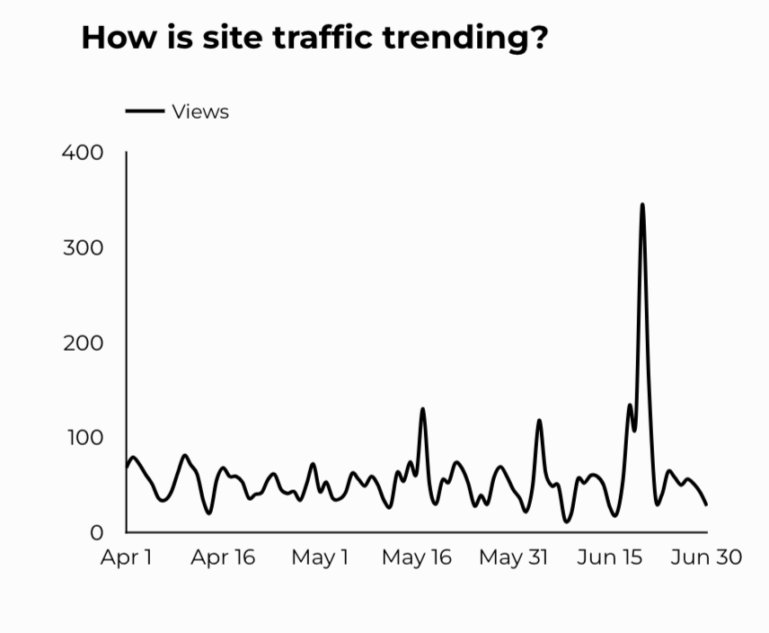
Traffic Highlights
The website received 5,207 views and 4,459 sessions.
The engagement rate was at 81%.
There are a total of 3,963 users. Of those users 848 were new.
CEAT

Slide 7
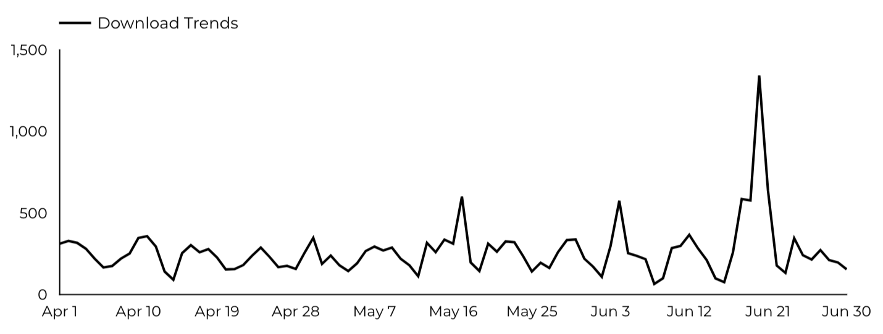
Engagement Insights & Highlights
CEAT Transfer Guide: Achieved 777 Downloads.
CEAT Transfer Guide Download Trends
CEAT

Slide 8
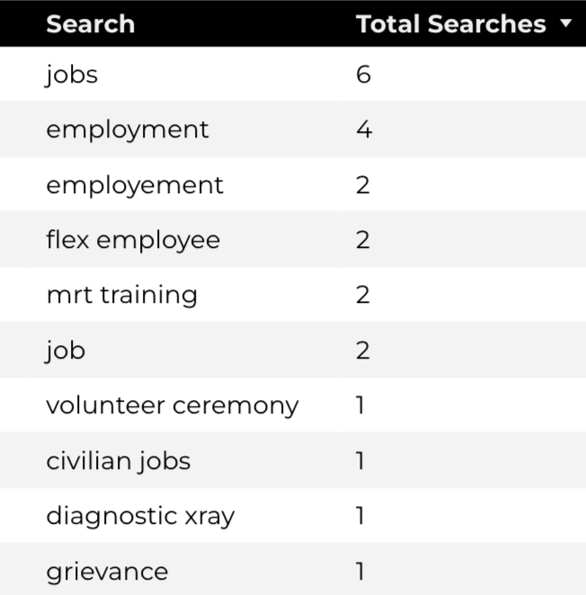
Search Insights & Highlights
42 total on-site searches on CEAT pages to find more information.
Top Searches
CEAT

Slide 9
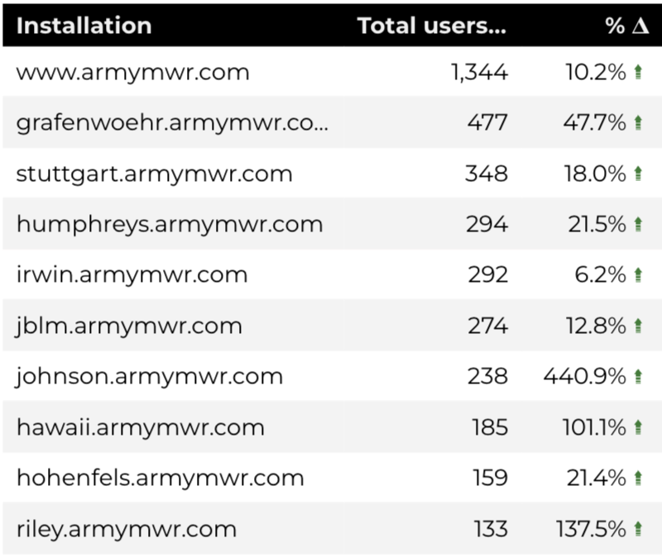
Traffic Highlights
HBB pages received 7,535 views and 6,965 sessions.
The engagement rate was at 66%.
The total number of users was 5,721, and there were 2,638 new users.
Top Installations
Home Based Business (HBB)

Slide 10
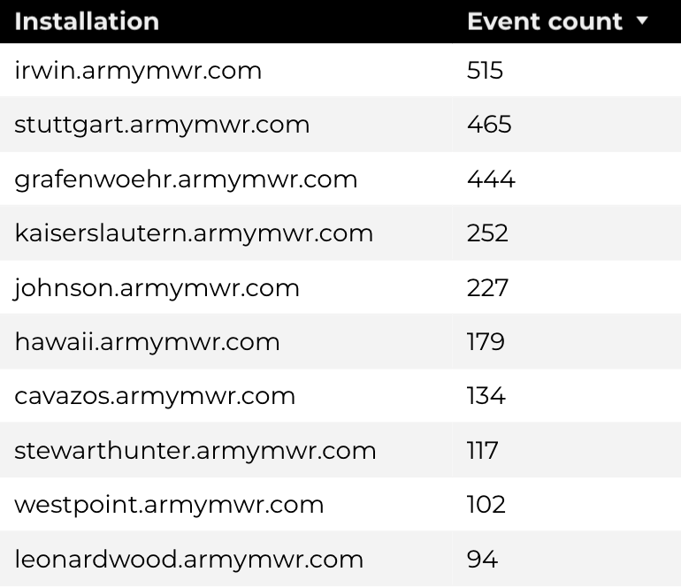
Engagement Insights & Highlights
There were 217 clicks to other websites to find more information.
2,861 people downloaded a PDF or a form.
133 people needed to talk to a real person.
Top Installations
(Downloads, Email, Phone Numbers, Outbound Links)
Home Based Business (HBB)

Slide 11
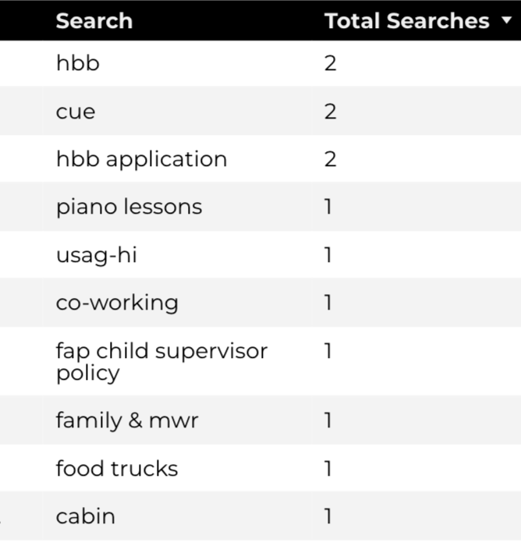
Search Insights & Highlights
41 total on-site searches on HBB pages to find more information.
2.63% of users left the site after performing a search.
Top Searches
Home Based Business (HBB)

