Slide 1
ACS First Quarter FY24 Insights
01 OCT – 31 DEC
​

Slide 2
EPW Search Improvement

Slide 3
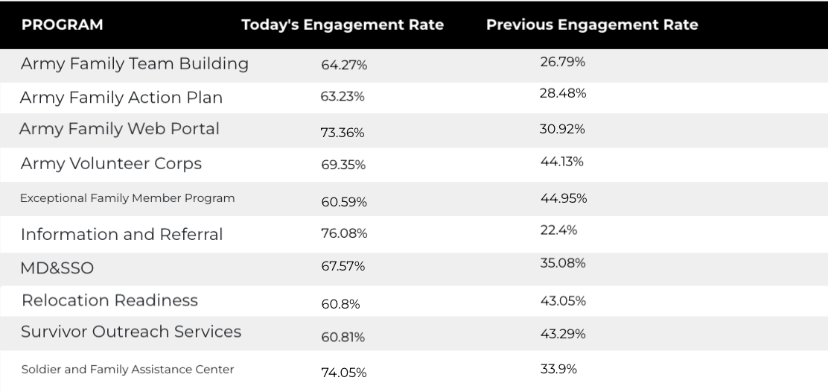
EPW Search Improvement

Slide 4
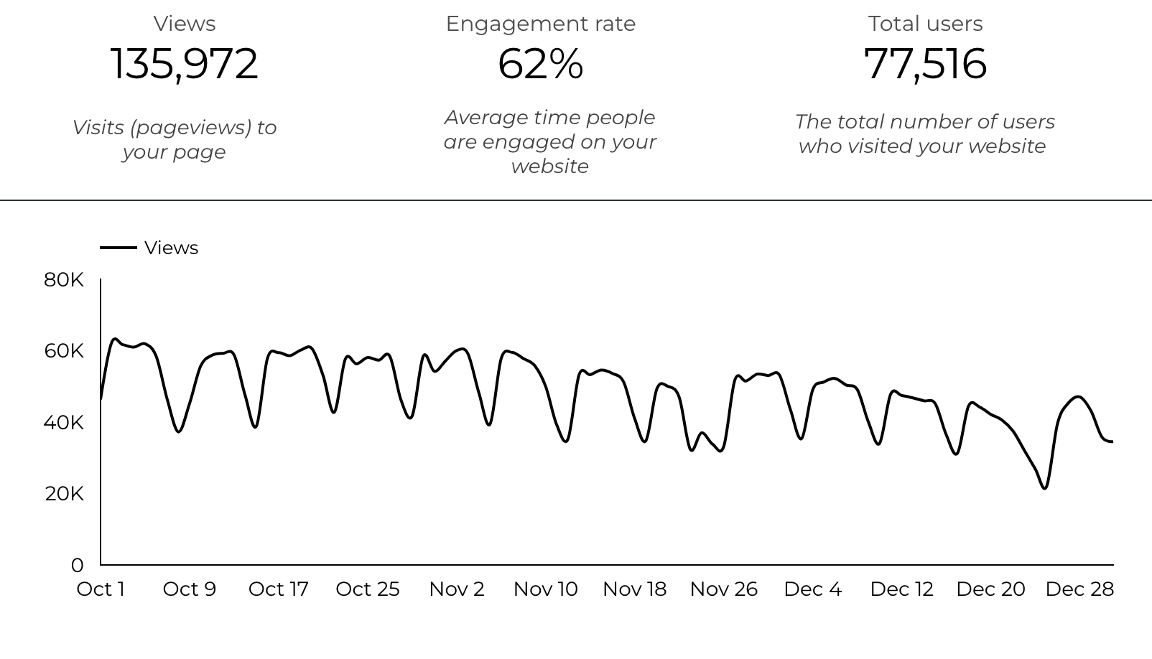
Web Analytics Summary

Slide 5
Traffic Highlights
ACS pages received 135,972 visits last quarter.
Engagement on ACS pages was 62%.
There were 77,516 total users who made a visit to ACS.
3,306 visits were directed from social media platforms.
Most of the social traffic came from Facebook.

Slide 6
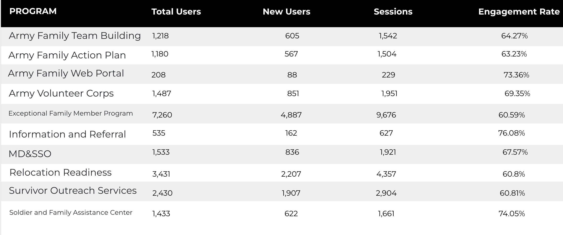
Visitor Highlights

Slide 7
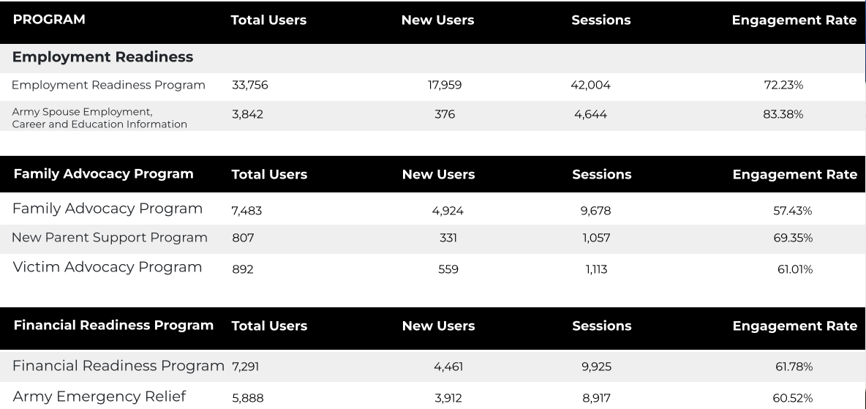
Visitor Highlights
Continued

Slide 8
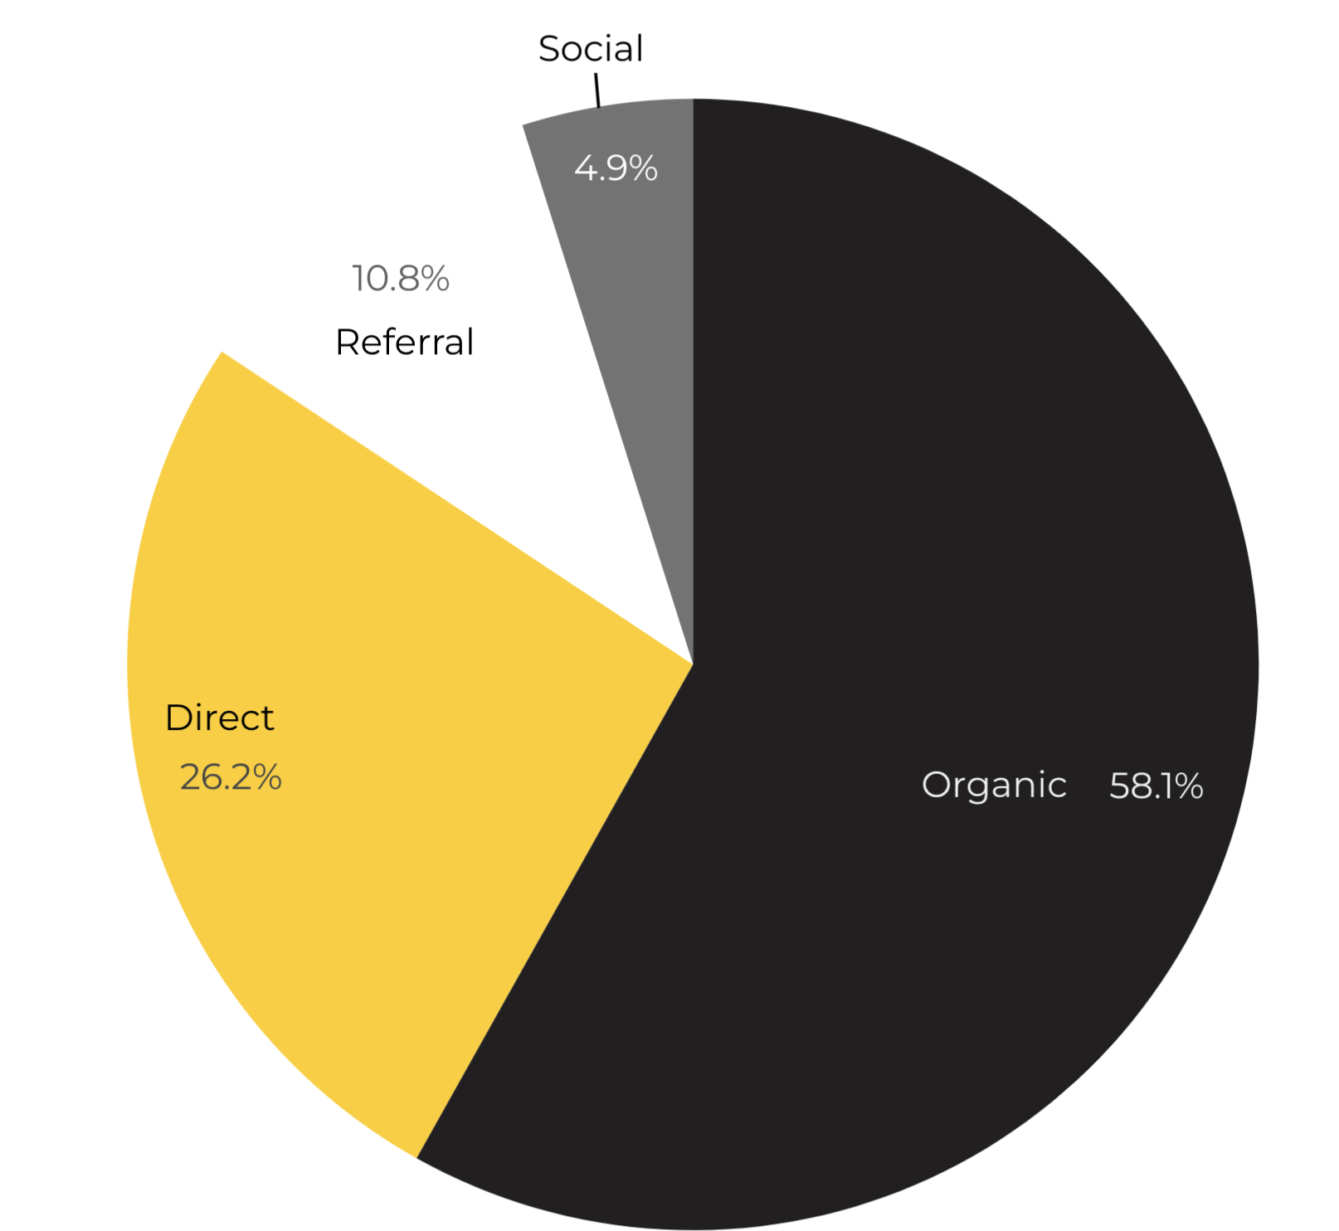
Marketing Reach
58.1% of visitors came from Organic Search engine queries.
26.2% of visitors came directly to the site (by typing in the address, using bookmarks, or email links).
10.8% of visitors came from Referral links on 3rd party web sites.
4.9% of visitors came from Social Media.
.01% Other (traffic that has an acquisition source Google doesn’t know how to classify).
Organic

Slide 9
Engagement Insights & Highlights
Last quarter had a total of 118,292 interactions on the ACS pages. (interactions are downloads, email clicks, phone number clicks, and outbound links).
Phone
Outbound Clicks

Slide 10
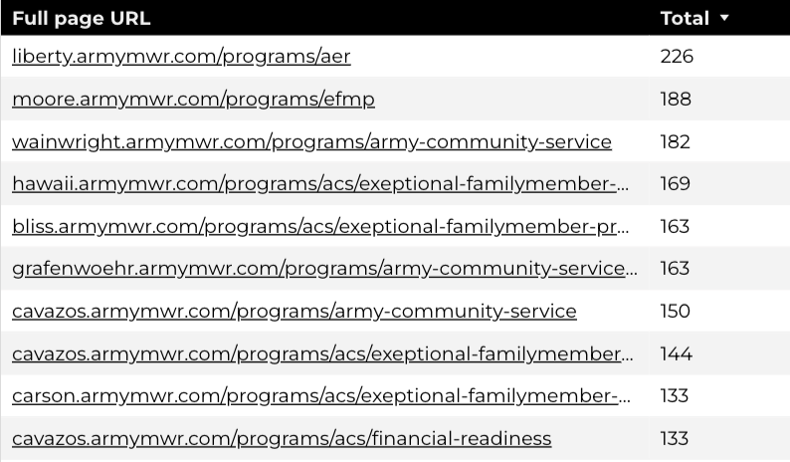
Insights & Highlights
Last quarter, 6,079 people required assistance from a live person.
Top ACS programs that received phone calls from the web.

Slide 11
Search Intent
Search intent is defined as being the underlying purpose behind an online query.
45% of searches were aimed at finding an answer to a specific question or acquiring general information.
40% of searches were conducted to explore brands or services with the intention of completing an action or making a purchase.
15% of searches were intended to locate a specific program page using the on-site search.

Slide 12
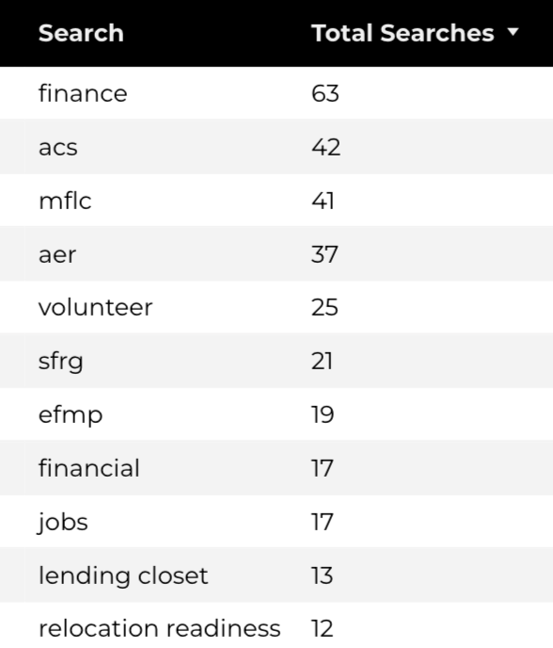
Search Insights
Top Search Terms
1,648 Total on-site searches on ACS pages to find more information.
2.5% of users left the site after performing a search.
+96.9% improvement in engagement after search compared to the previous quarter.
Notes:
.

Slide 13
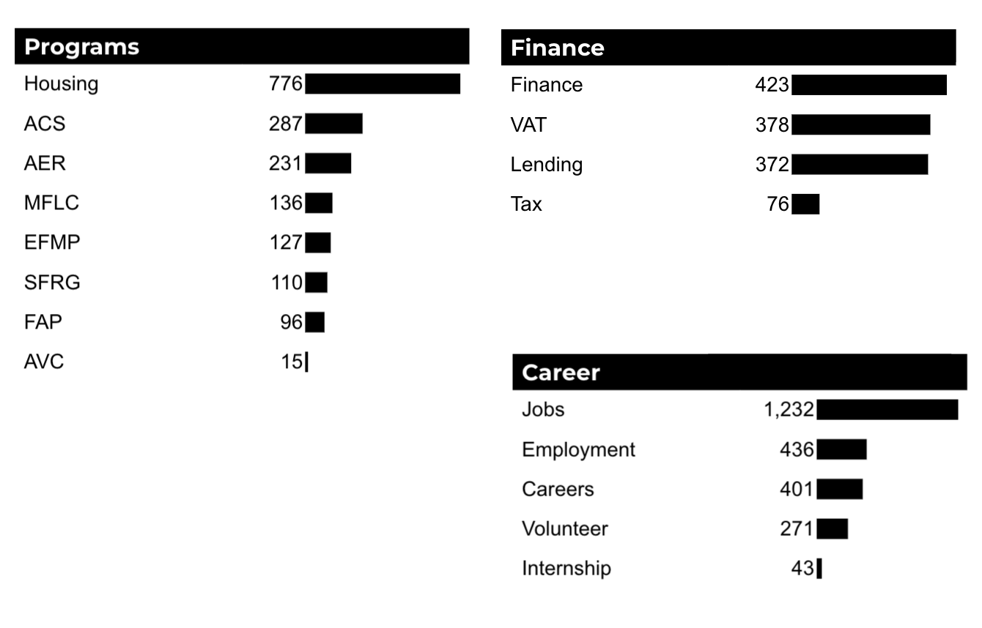
What Are The Top Search Sub-Topics?
The most popular search categories and terms within ACS.

