Slide 1
Support Services Annual FY23 Insights
01 Oct – 30 Sept
​

Slide 2
Web Analytics Summary
Program Roll-up

Slide 3
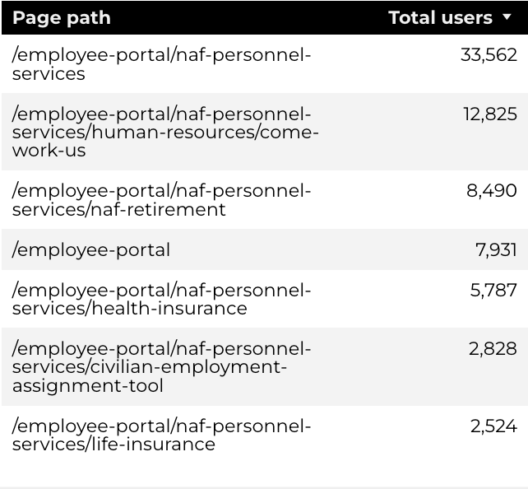
Traffic Highlights
NAF Personnel Services
The program received 128,073 views and 73,886 sessions.
The engagement rate is at 44%.
There are a total of 60,713 users. Of those users 42,079 are new.

Slide 4
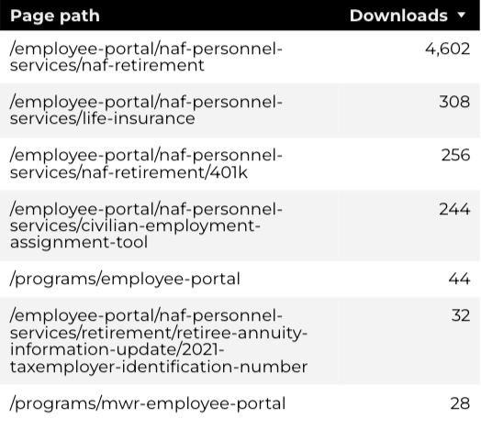
Engagement Insights & Highlights
NAF Personnel Services
5,584 people downloaded a PDF or a form.

Slide 5
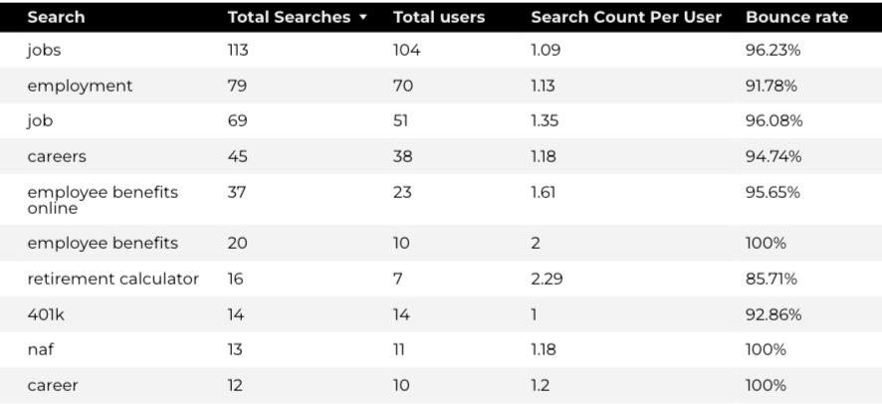
Search Insights & Highlights
NAF Personnel Services
There were 1,342 total on-site searches on NAF Personnel Services pages to find more information.
95.34% of users left the site after performing a search.
Top Searches

Slide 6
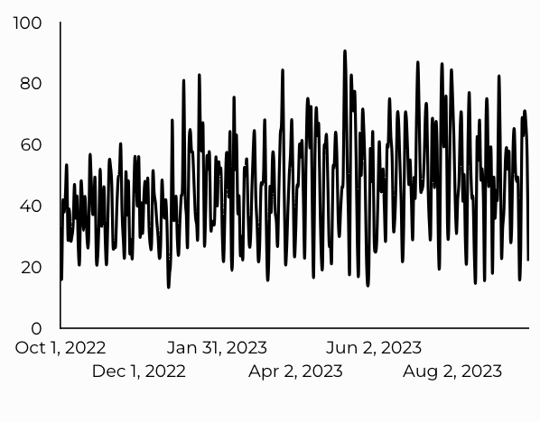
Traffic Highlights
CEAT
CEAT Traffic Trends
CEAT received 16,685 views and 15,289 sessions.
The engagement rate is at 16%.
There are a total of 13,186 users. Of those users 2,677 are new.

Slide 7
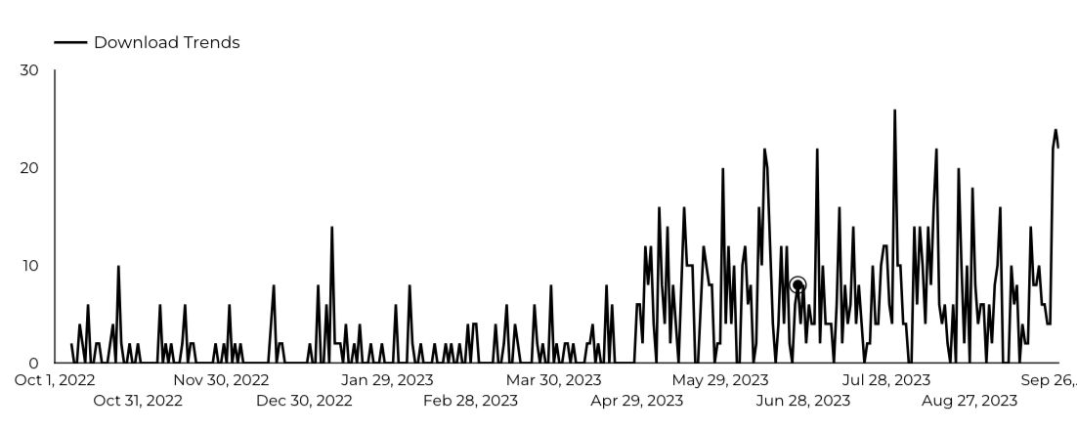
Engagement Insights & Highlights
CEAT
There were 1,532 clicks to download the CEAT Transfer Guide.
CEAT Transfer Guide Download Trends

Slide 8
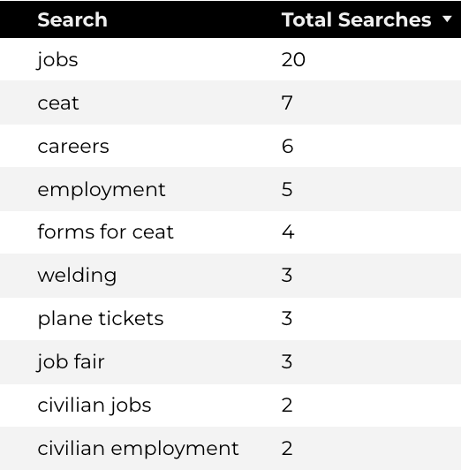
Search Insights & Highlights
CEAT
Top Searches
159 total searches on CEAT pages to find more information.
96.55% of users left the site after performing a search.

Slide 9
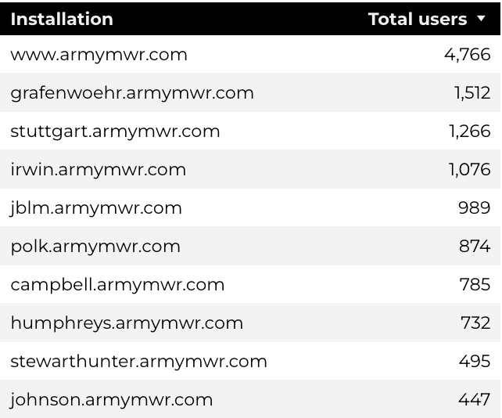
Traffic Highlights
Home Based Business (HBB)
Top Installations
HBB pages received 27,721 views and 24,248 sessions.
The engagement rate was 31%.
The total number of users was 19,427, and there were 8,135 new users.

Slide 10
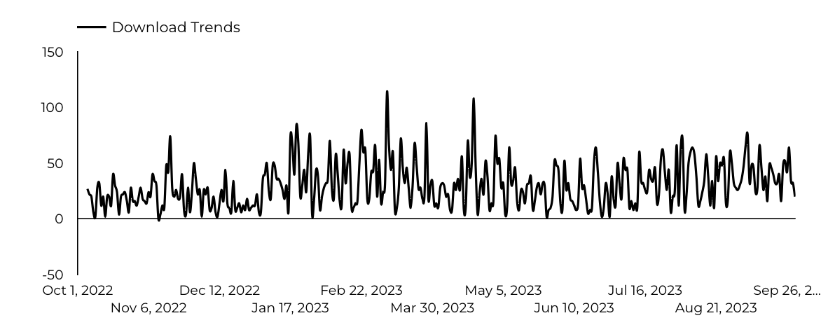
Engagement Insights & Highlights
Home Based Business (HBB)
10,896 people downloaded the Home-Based Business Application.

Slide 11
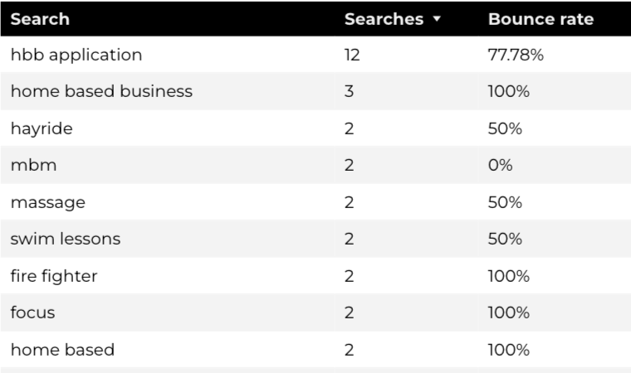
Search Insights & Highlights
Home Based Business (HBB)
Top Searches
273 total on-site searches on HBB pages to find more information.
94.17% of users left the site after performing a search.

